Slide 1
Chapter 6
Curve Fitting and Interpolation

Slide 2
Core Topics
(i) Curve fitting with a linear equation (6.2)
(ii) Curve fitting with a non-linear equation by writing the equation in linear form (6.3)
(iii) Curve fitting with quadratic and higher order polynomials (6.4)
(iv) Interpolation using a single polynomial (6.5)
(v) Lagrange polynomials (6.5.1)
(vi) Newton’s polynomials (6.5.2)
(vii) Piecewise (spline) interpolation (6.6)
(viii) Use of MATLAB built-in functions for curve fitting and interpolation (6.7)
(ix) Curve fitting with a linear combination of nonlinear functions (6.8)

Slide 3
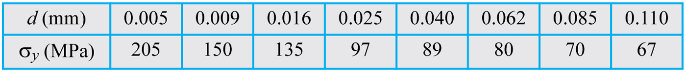
Background:
Experimental data is usually discrete having been performed for a discrete set of data points.
Oftentimes we need to approximate these data with a function that can be used to extrapolate the data (give data outside the range of measurement) or indeed to estimate the behaviour of the function for a change in function parameters. This process is known as curve fitting. In other words curve fitting is obtaining a mathematical function that governs the results. By way of example we have the data for the strength of a metal versus grain size:

Slide 4
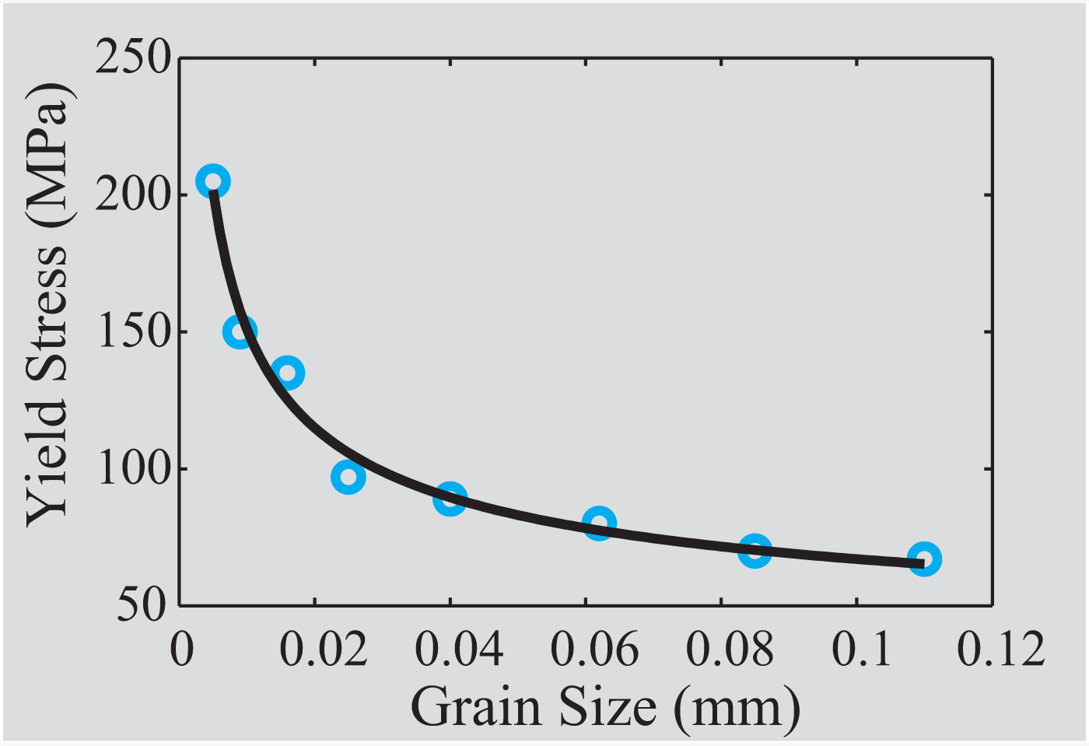
Background:
A plot of the data points and a curve fit is given here:
Note how the chosen curve does not pass through most points exactly but it does give us a good picture of the overall behaviour of the data. Knowing the function, we can extrapolate the data and also see how it would behave for a change in parameters.

Slide 5
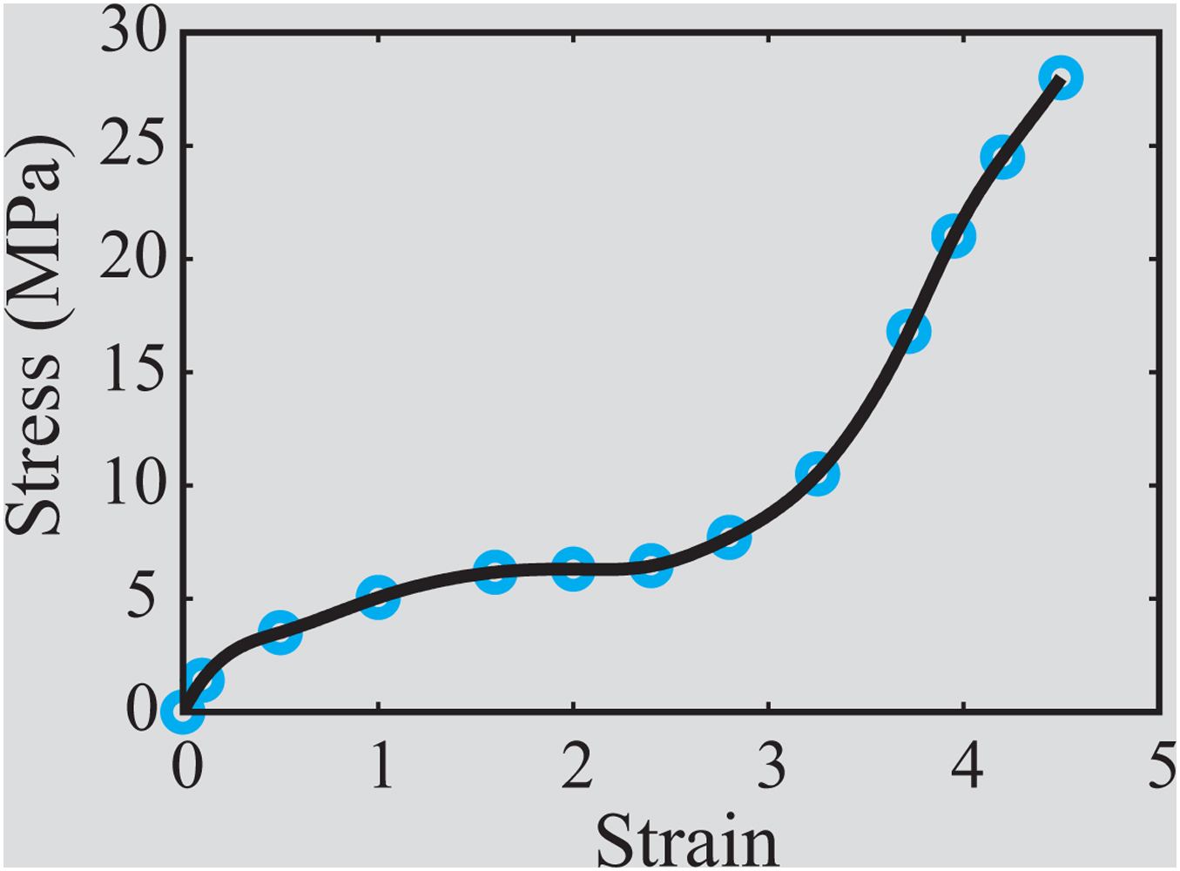
Background:
Oftentimes we need to estimate the value of the function between data points. This is best done by finding a function or functions that fit the data exactly. This process is known as interpolation. Interpolation is used to find intermediate values. Note that interpolation can also be done on the basis of curve fitting but the answer will not be as accurate.

Slide 6
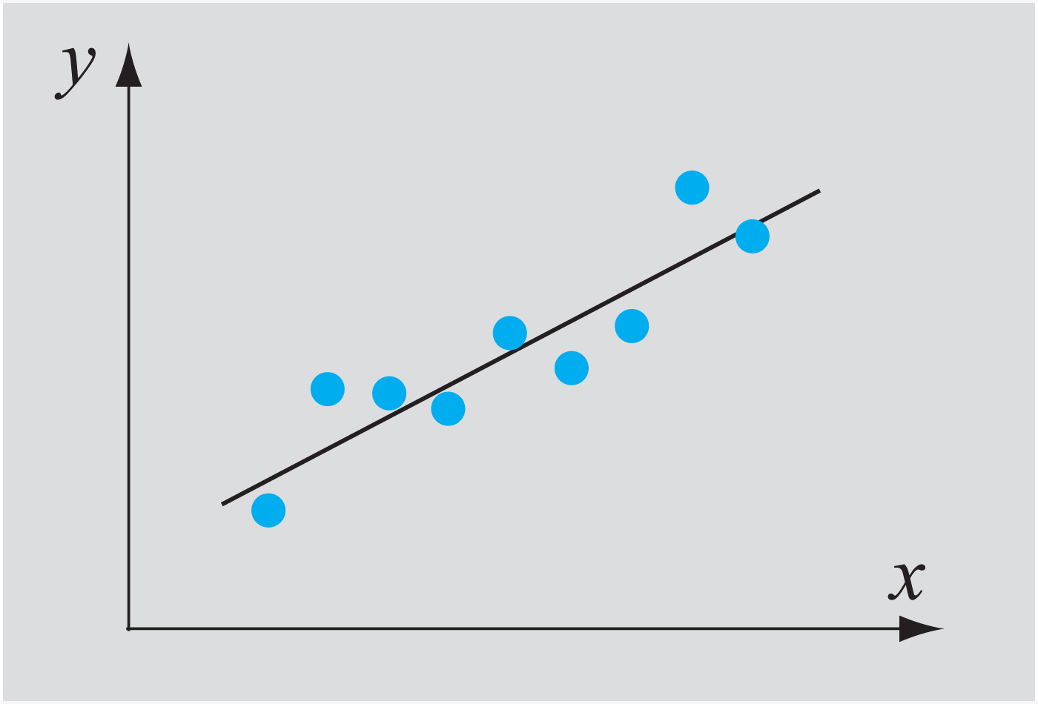
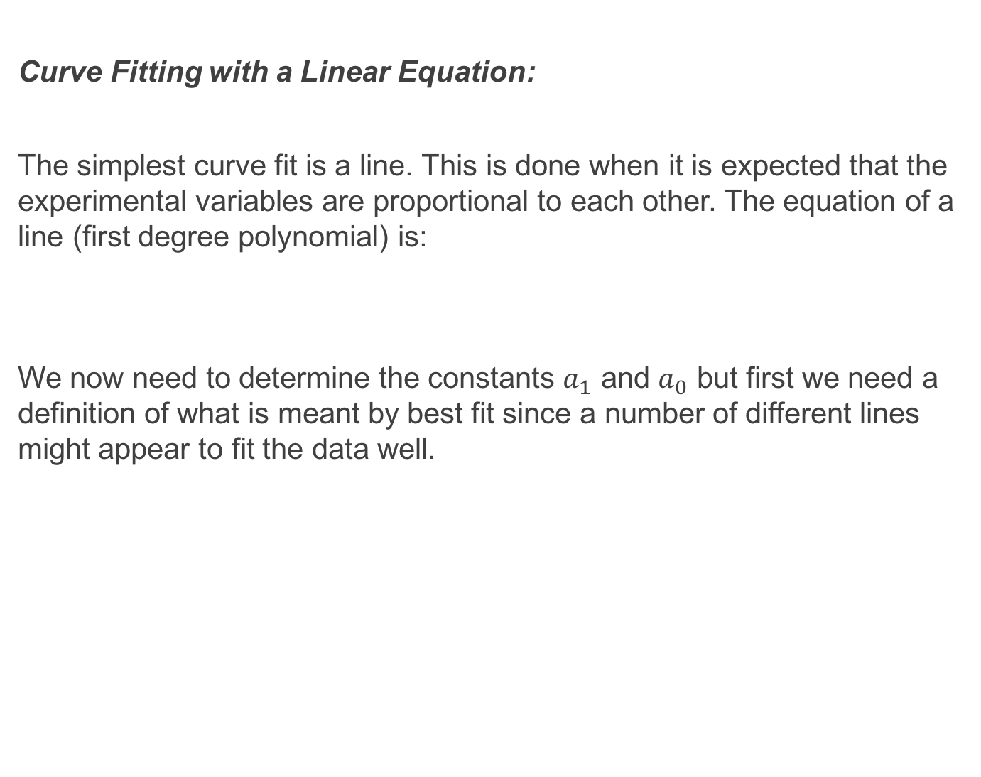
Curve Fitting with a Linear Equation:
The simplest curve fit is a line. This is done when it is expected that the experimental variables are proportional to each other. The equation of a line (first degree polynomial) is:
We now need to determine the constants $a_{1}$ and $a_{0}$ but first we need a definition of what is meant by best fit since a number of different lines might appear to fit the data well.

Slide 7
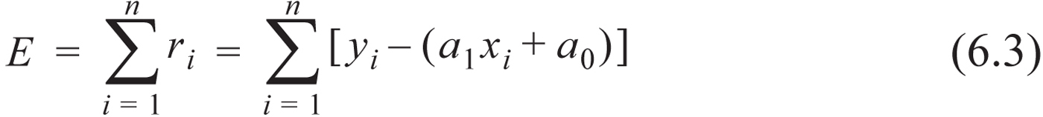
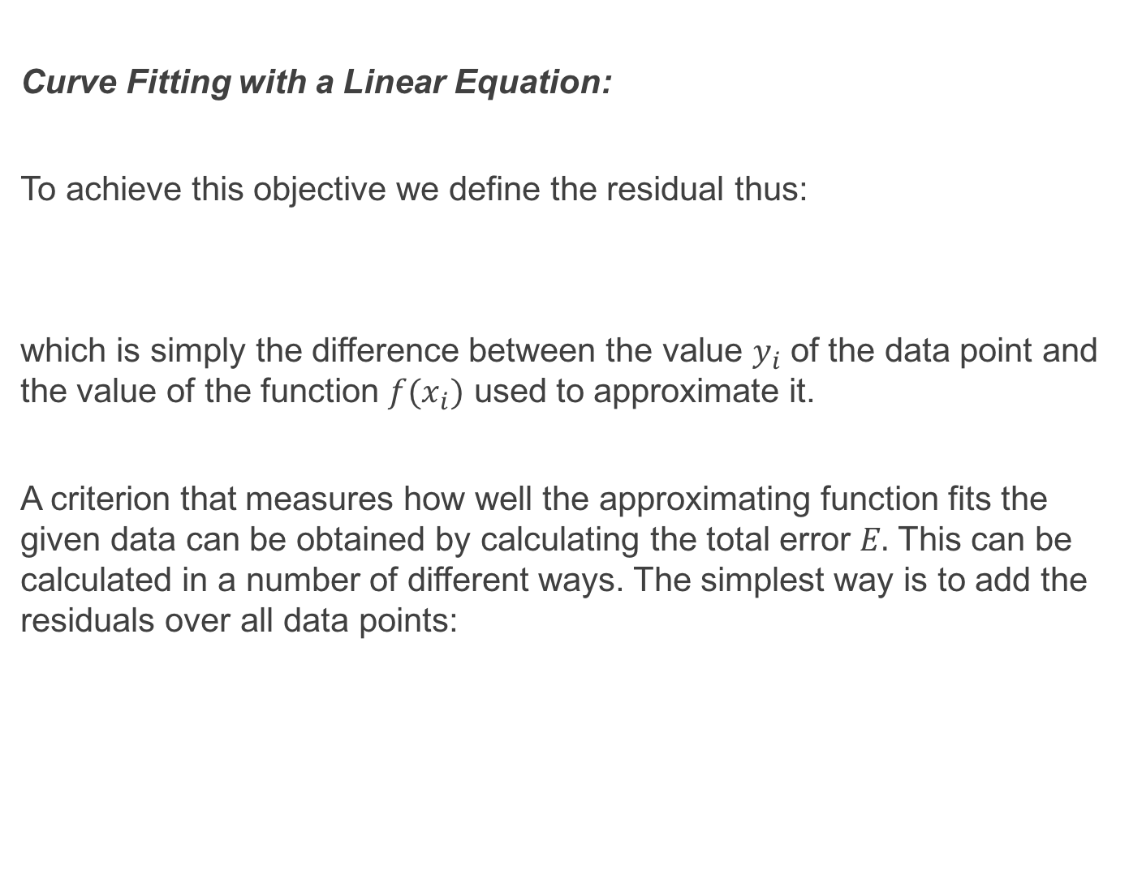
Curve Fitting with a Linear Equation:
To achieve this objective we define the residual thus:
which is simply the difference between the value $y_{i}$ of the data point and the value of the function $f(x_{i})$ used to approximate it.
A criterion that measures how well the approximating function fits the given data can be obtained by calculating the total error $E.$ This can be calculated in a number of different ways. The simplest way is to add the residuals over all data points:

Slide 8
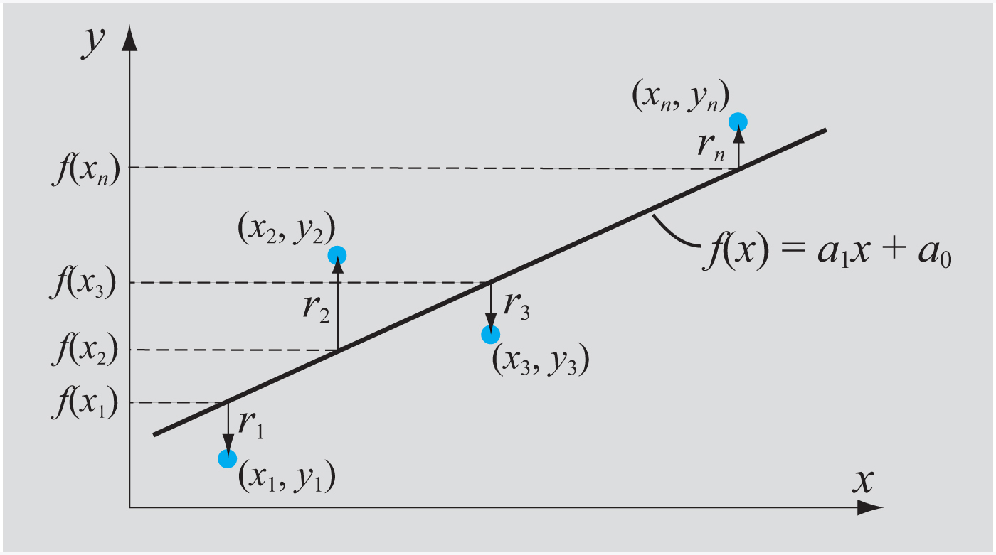
Curve Fitting with a Linear Equation:

Slide 9
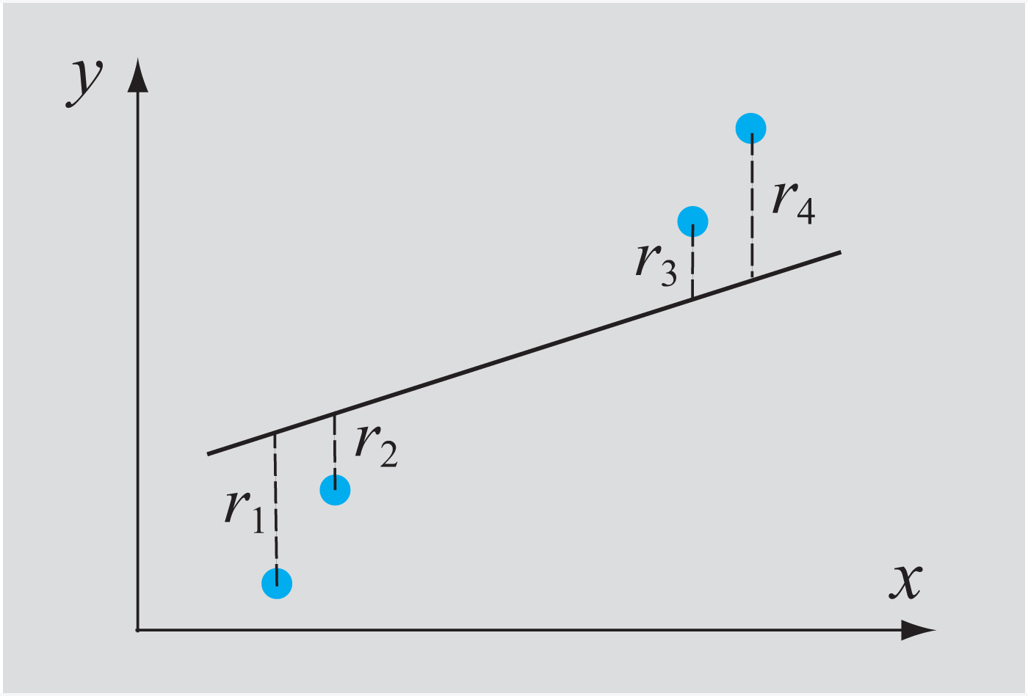
Curve Fitting with a Linear Equation:
The total error does not however give a good measure of the overall fit. This is because a bad fit with positive and negative residuals (both of which could be large) may yield a small overall error because positive and negative residuals may cancel. This scenario is illustrated in the following figure where it is clear that a line with a higher slope would better fit the data.

Slide 10
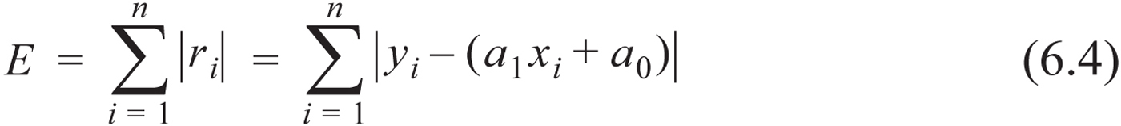
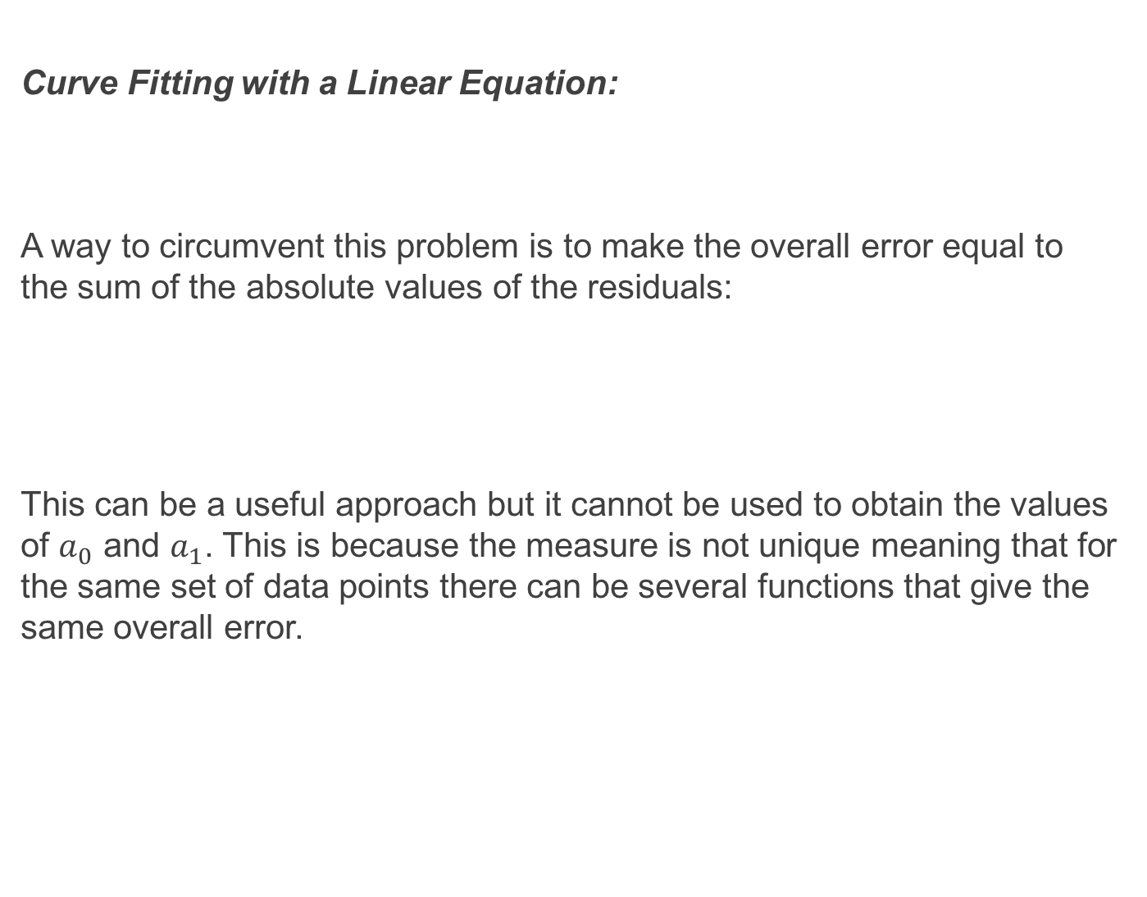
Curve Fitting with a Linear Equation:
A way to circumvent this problem is to make the overall error equal to the sum of the absolute values of the residuals:
This can be a useful approach but it cannot be used to obtain the values of $a_{0}$ and $a_{1}$. This is because the measure is not unique meaning that for the same set of data points there can be several functions that give the same overall error.

Slide 11
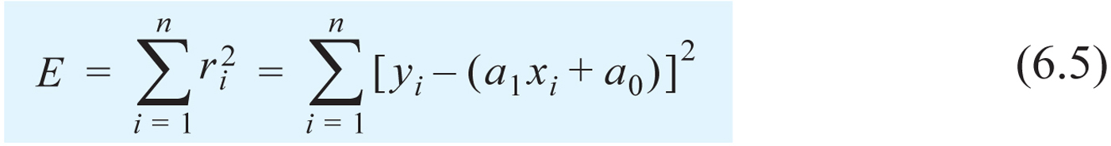
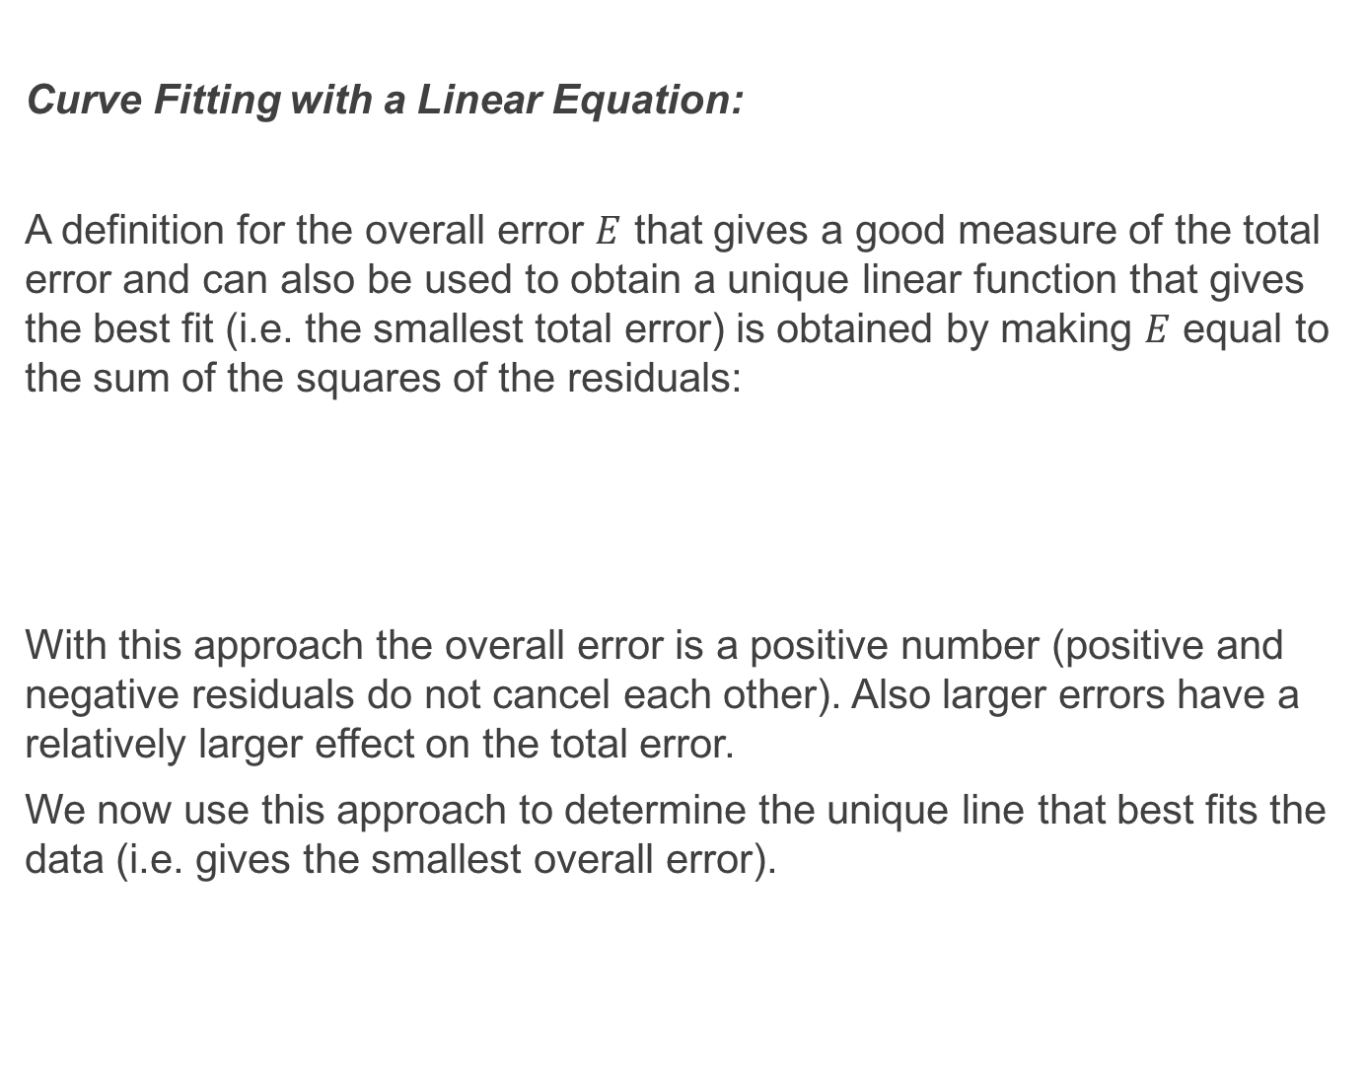
Curve Fitting with a Linear Equation:
A definition for the overall error $E$ that gives a good measure of the total error and can also be used to obtain a unique linear function that gives the best fit (i.e. the smallest total error) is obtained by making $E$ equal to the sum of the squares of the residuals:
With this approach the overall error is a positive number (positive and negative residuals do not cancel each other). Also larger errors have a relatively larger effect on the total error.
We now use this approach to determine the unique line that best fits the data (i.e. gives the smallest overall error).

Slide 12
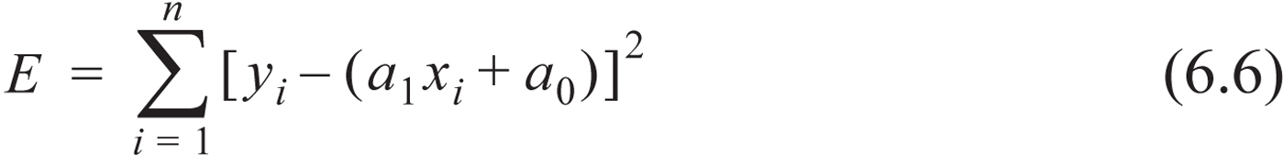
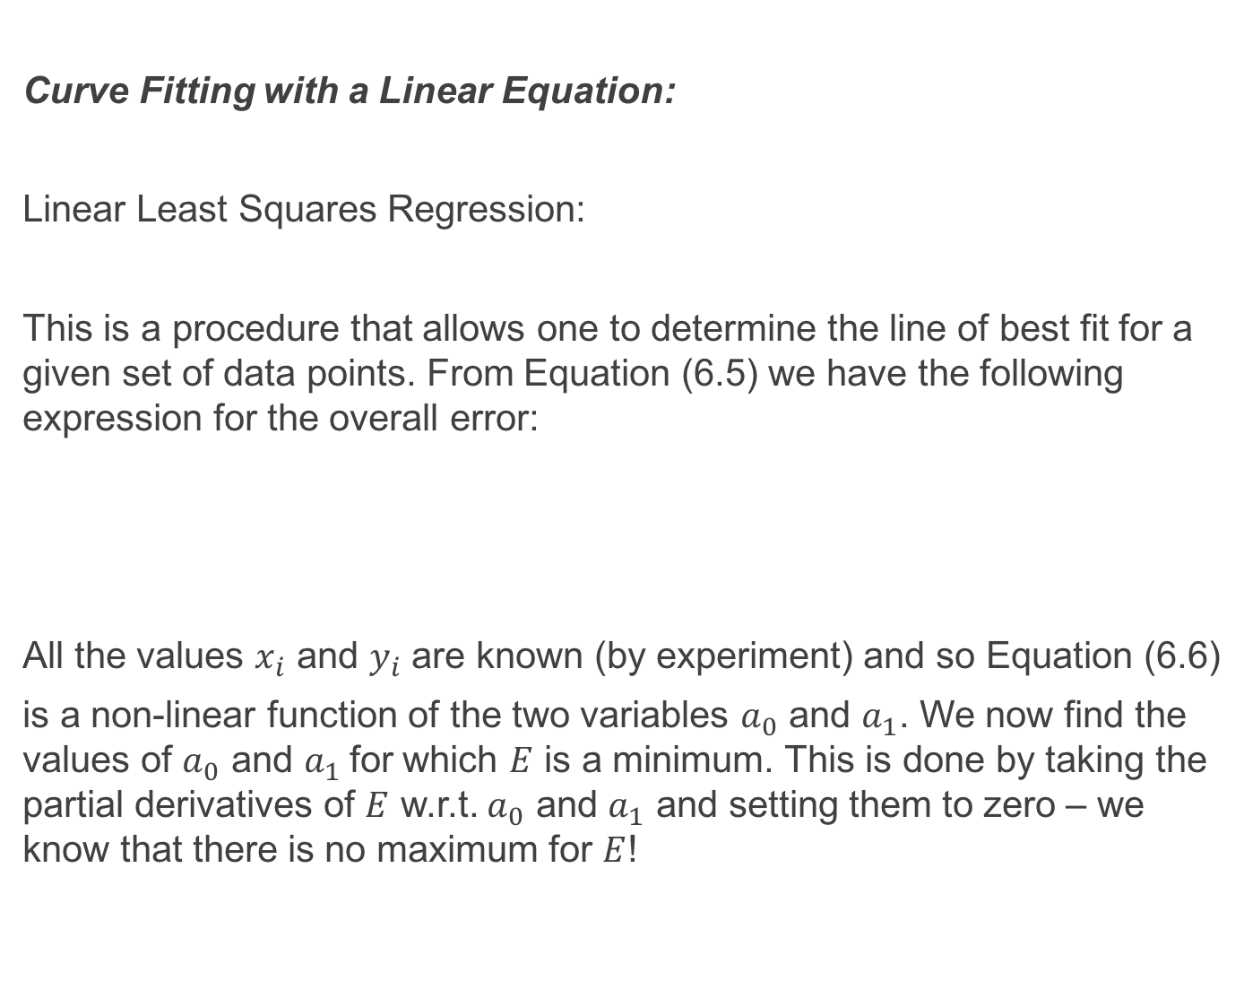
Curve Fitting with a Linear Equation:
Linear Least Squares Regression:
This is a procedure that allows one to determine the line of best fit for a given set of data points. From Equation (6.5) we have the following expression for the overall error:
All the values $x_{i}$ and $y_{i}$ are known (by experiment) and so Equation (6.6)
is a non-linear function of the two variables $a_{0}$ and $a_{1}$. We now find the values of $a_{0}$ and $a_{1}$for which $E$ is a minimum. This is done by taking the partial derivatives of $E$ w.r.t. $a_{0}$ and $a_{1}$ and setting them to zero – we know that there is no maximum for $E$!

Slide 13
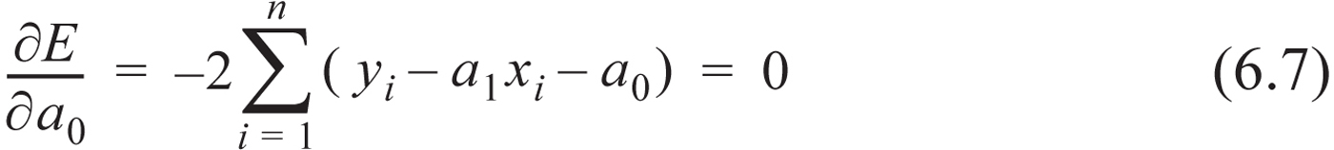
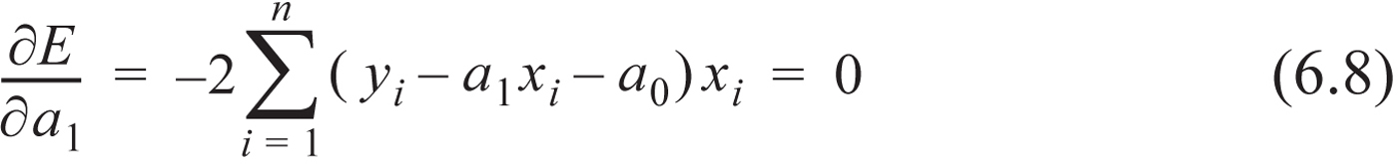
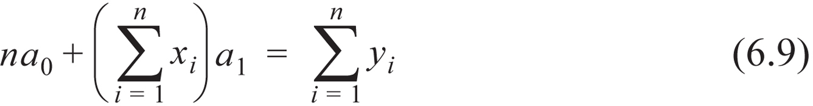
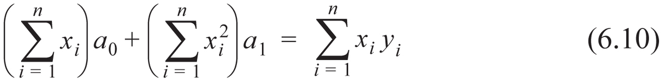
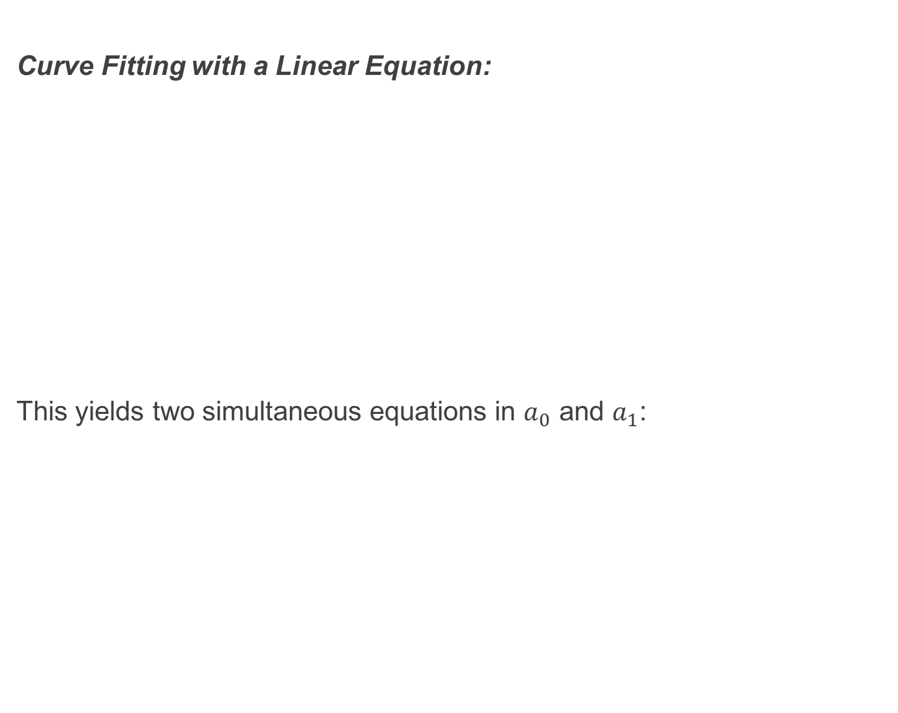
Curve Fitting with a Linear Equation:
This yields two simultaneous equations in $a_{0}$ and $a_{1}$:

Slide 14
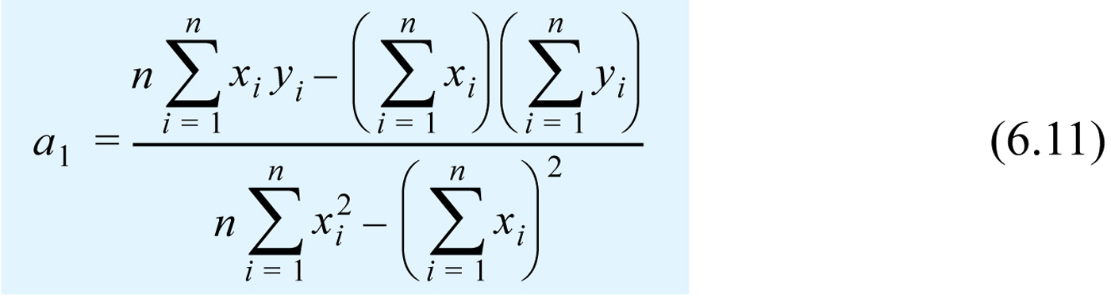
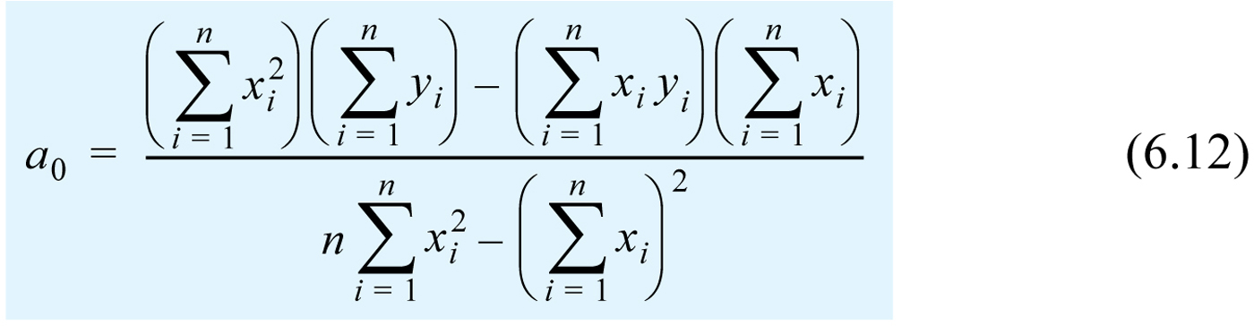
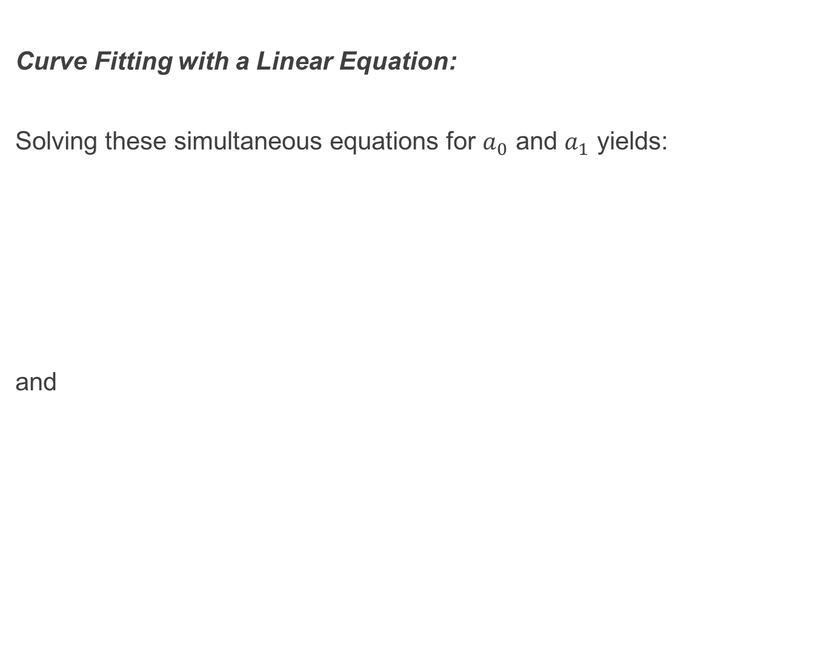
Curve Fitting with a Linear Equation:
Solving these simultaneous equations for $a_{0}$ and $a_{1}$ yields:
and

Slide 15
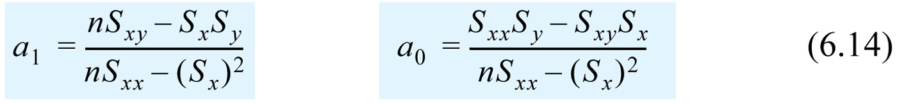
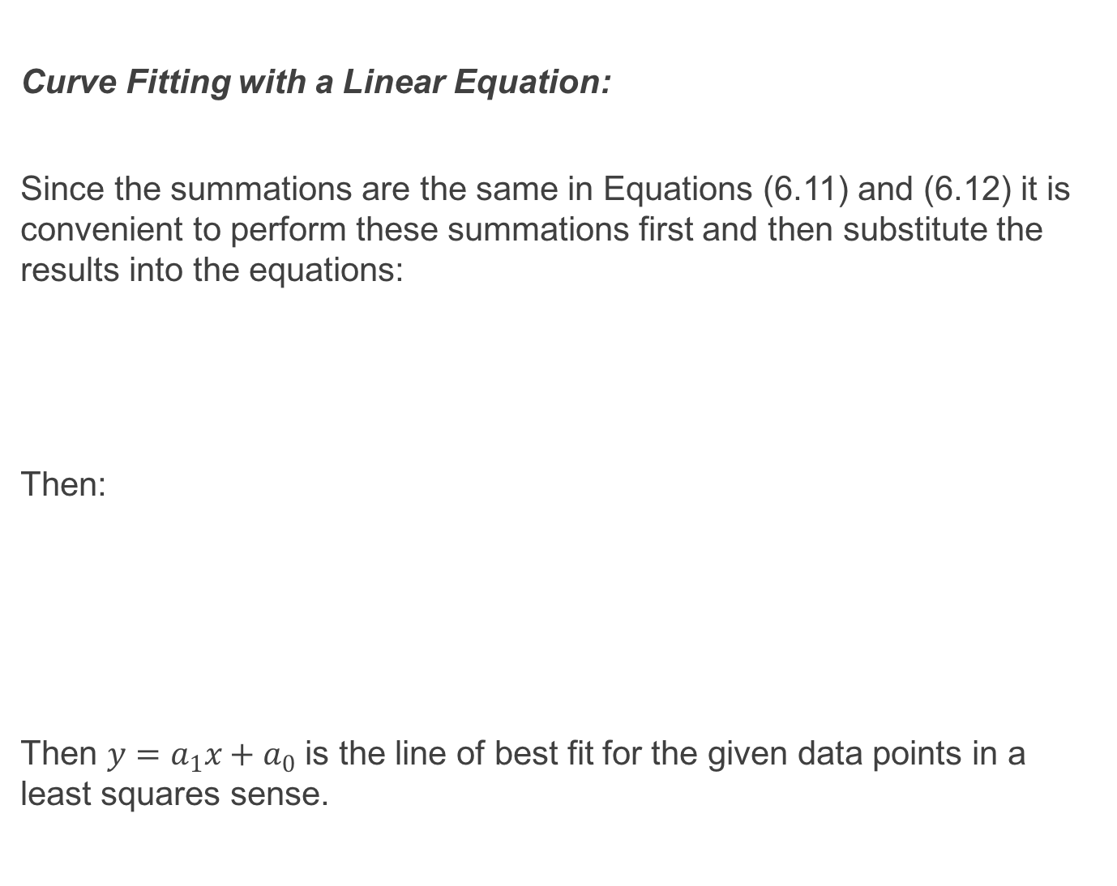
Curve Fitting with a Linear Equation:
Since the summations are the same in Equations (6.11) and (6.12) it is convenient to perform these summations first and then substitute the results into the equations:
Then:
Then $y=a_{1}x+a_{0}$ is the line of best fit for the given data points in a least squares sense.

Slide 16
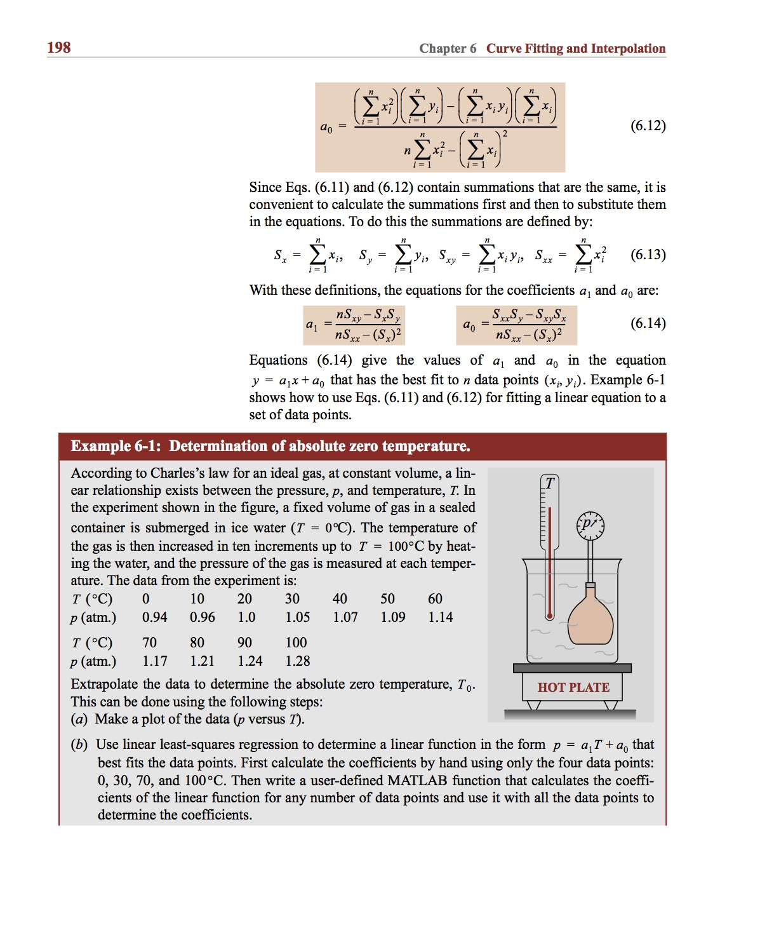
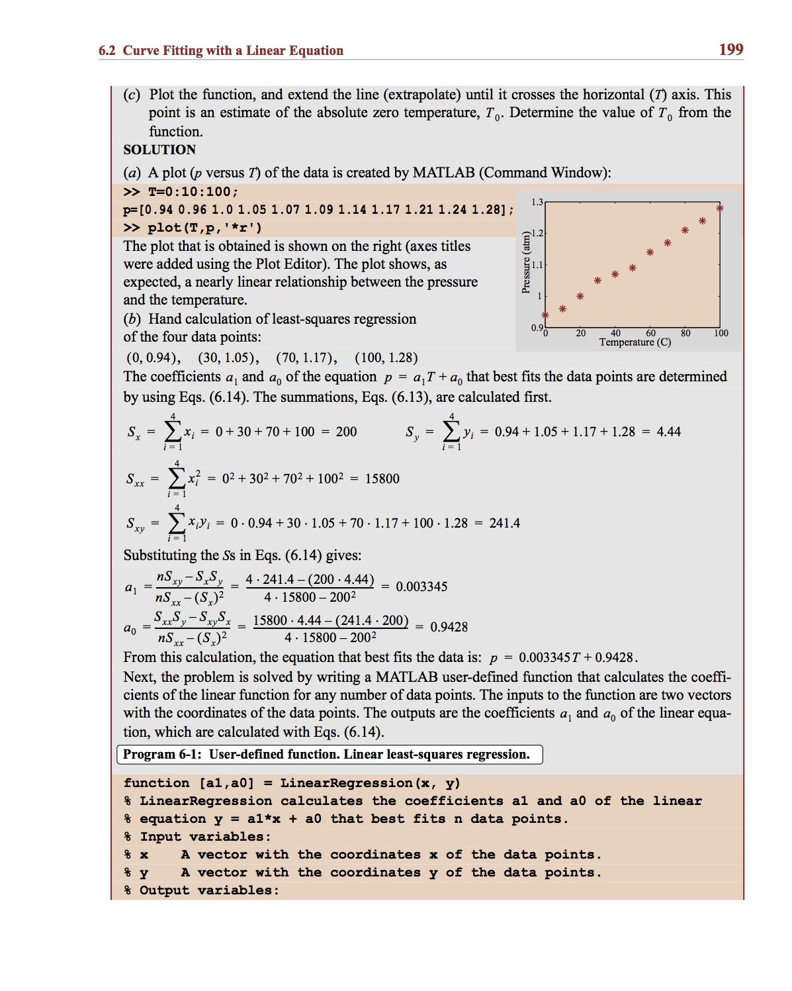
Example:

Slide 17
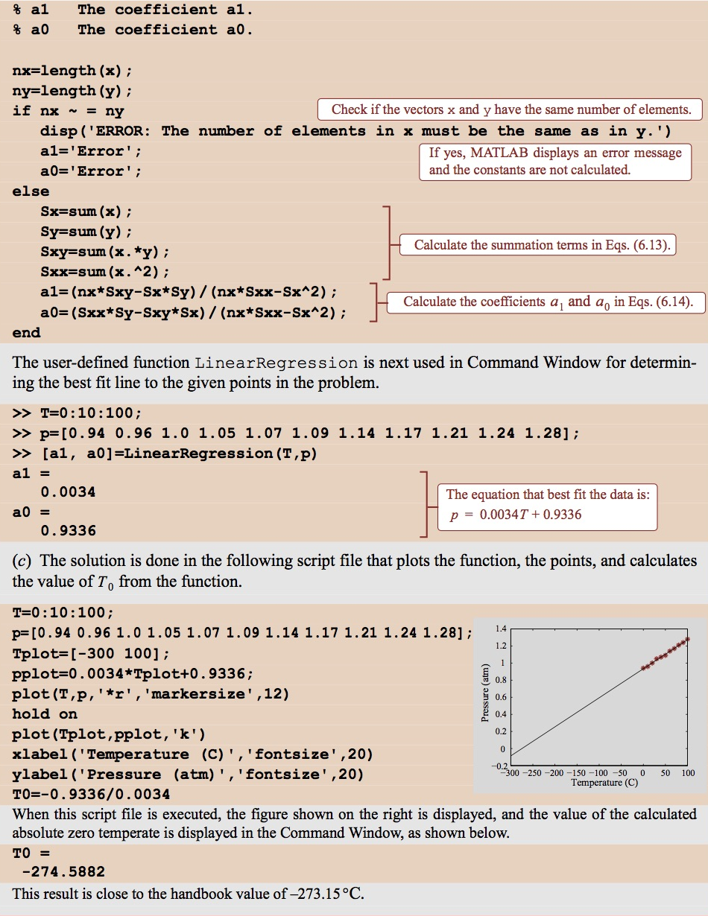
Example:

Slide 18
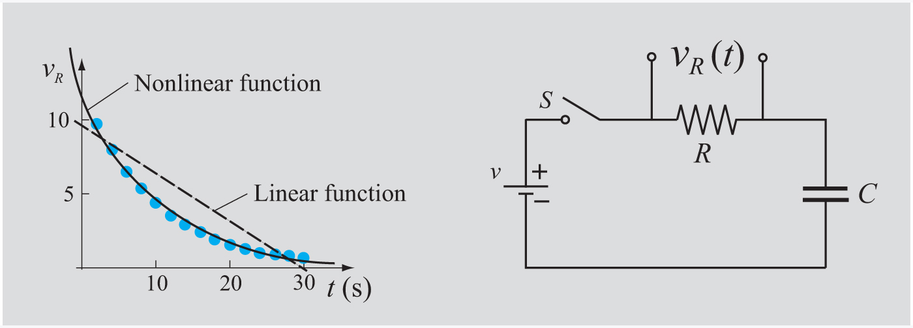
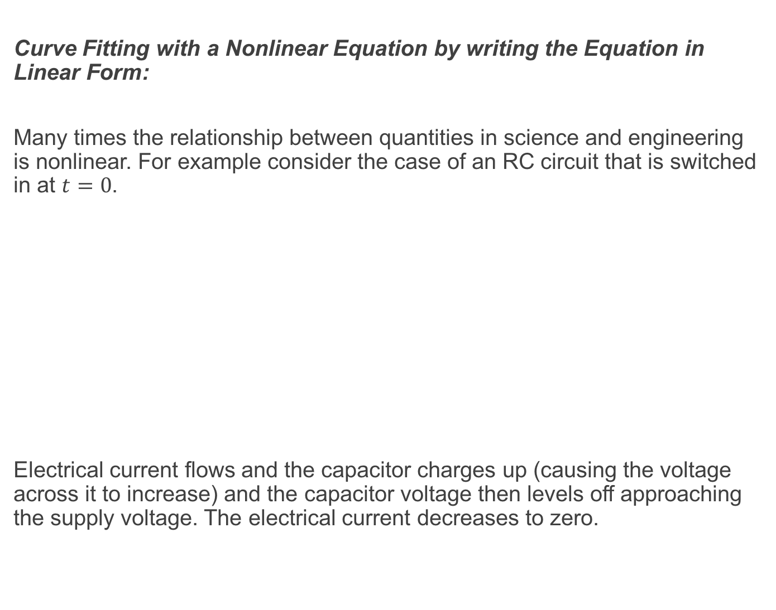
Curve Fitting with a Nonlinear Equation by writing the Equation in Linear Form:
Many times the relationship between quantities in science and engineering is nonlinear. For example consider the case of an RC circuit that is switched in at $t=0$.
Electrical current flows and the capacitor charges up (causing the voltage across it to increase) and the capacitor voltage then levels off approaching the supply voltage. The electrical current decreases to zero.

Slide 19
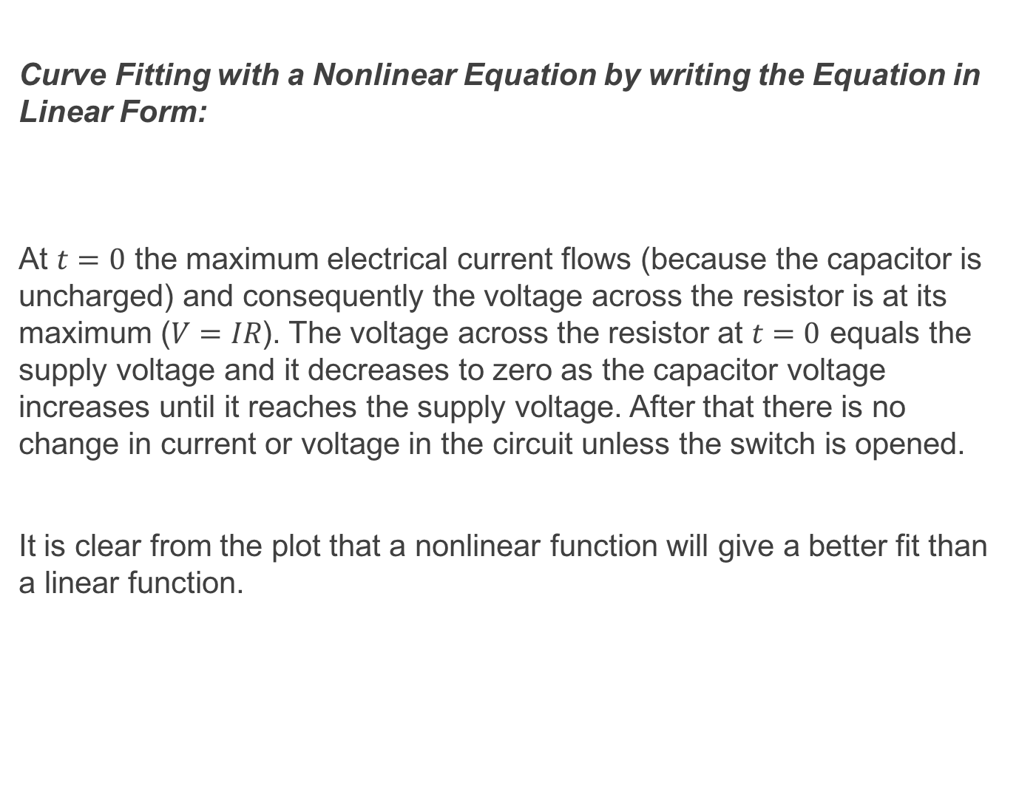
Curve Fitting with a Nonlinear Equation by writing the Equation in Linear Form:
At $t=0$ the maximum electrical current flows (because the capacitor is uncharged) and consequently the voltage across the resistor is at its maximum ($V=IR$). The voltage across the resistor at $t=0$ equals the supply voltage and it decreases to zero as the capacitor voltage increases until it reaches the supply voltage. After that there is no change in current or voltage in the circuit unless the switch is opened.
It is clear from the plot that a nonlinear function will give a better fit than a linear function.

Slide 20
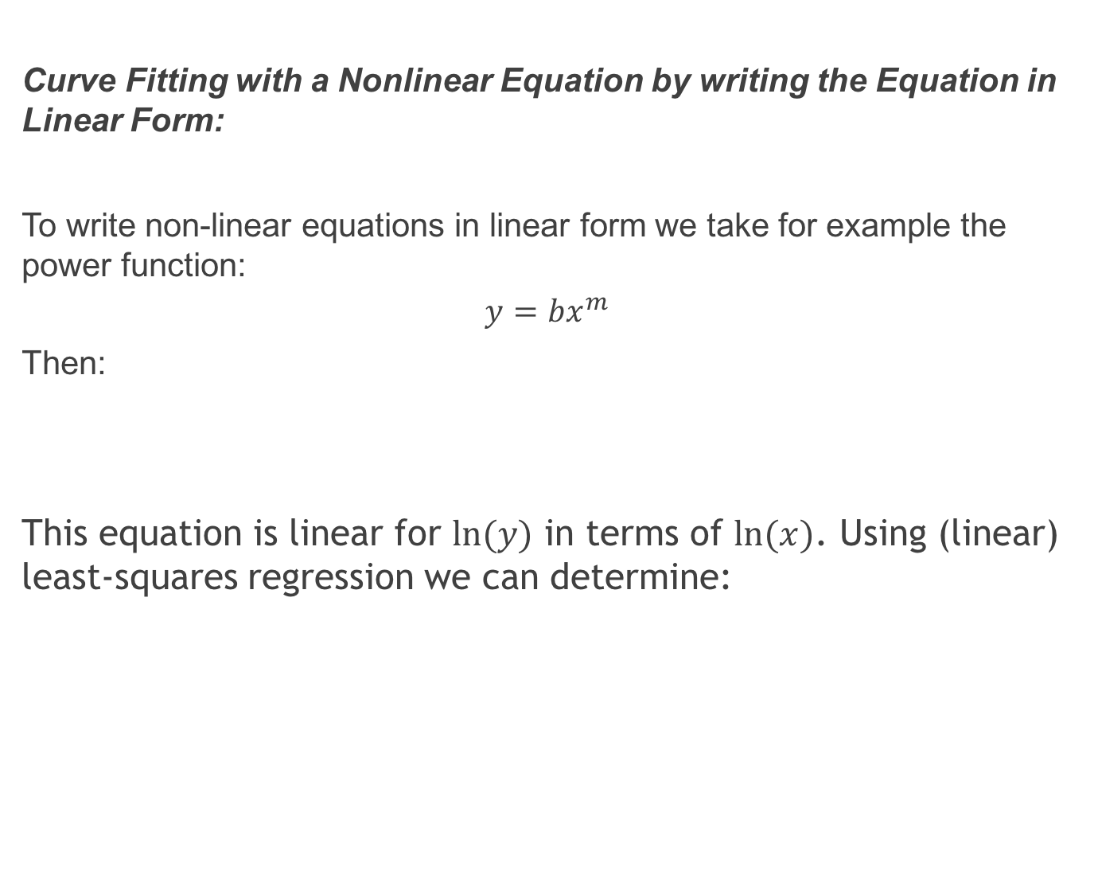
Curve Fitting with a Nonlinear Equation by writing the Equation in Linear Form:
To write non-linear equations in linear form we take for example the power function:
$$y=bx^{m}$$
Then:
This equation is linear for $ln⁡(y)$ in terms of $ln⁡(x)$. Using (linear) least-squares regression we can determine:

Slide 21
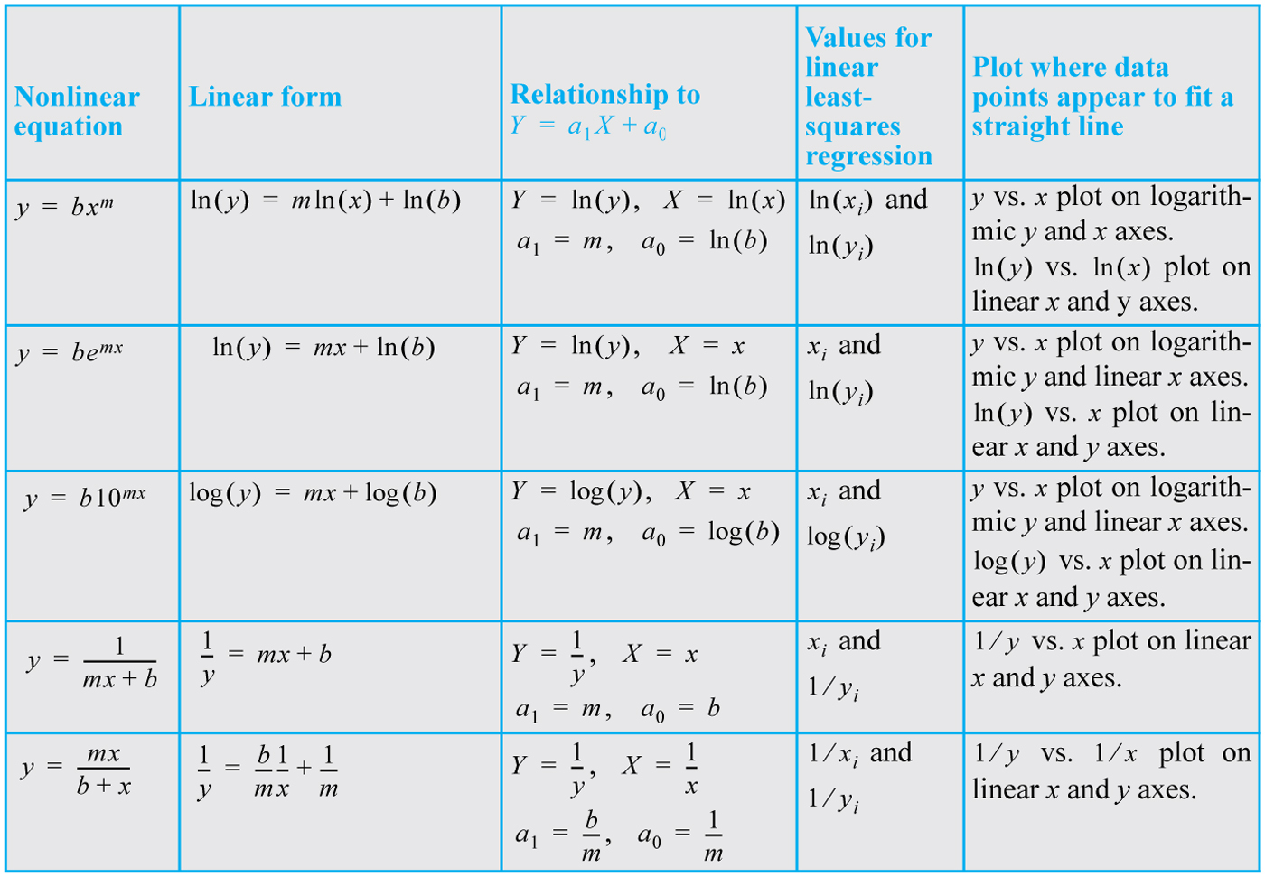
Curve Fitting with a Nonlinear Equation by writing the Equation in Linear Form:
Examples of nonlinear functions that can be used with least-squares regression to give a best fit:

Slide 22
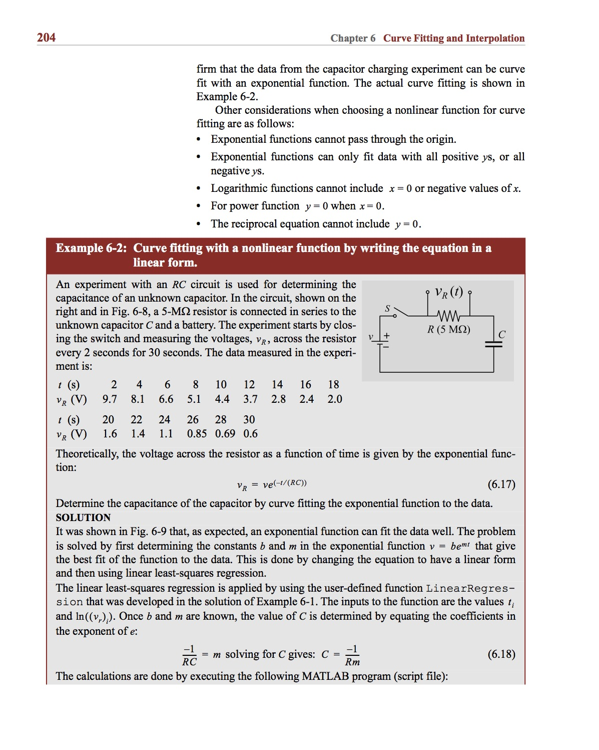
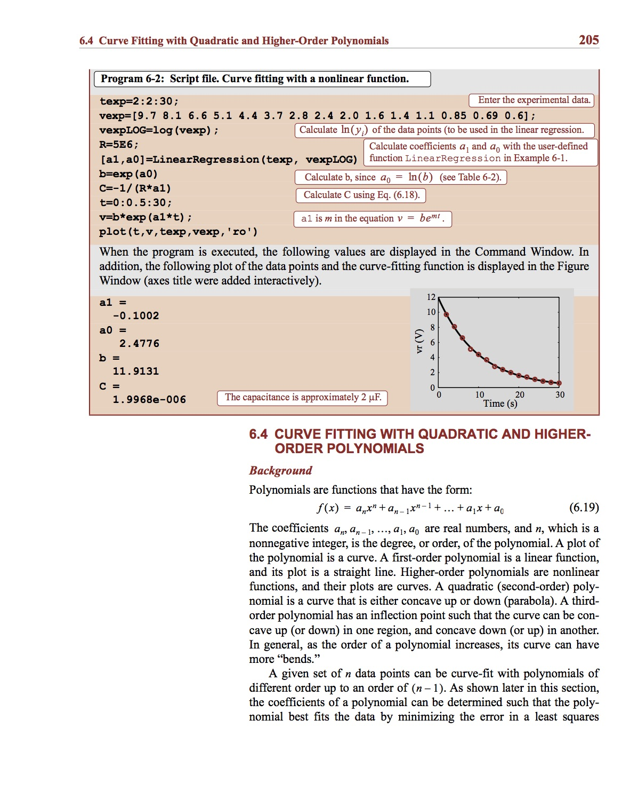
Example:

Slide 23
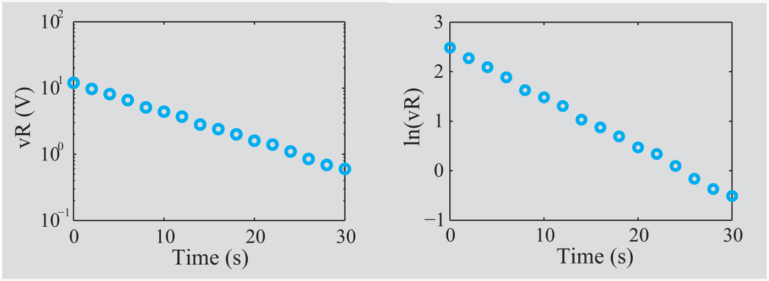
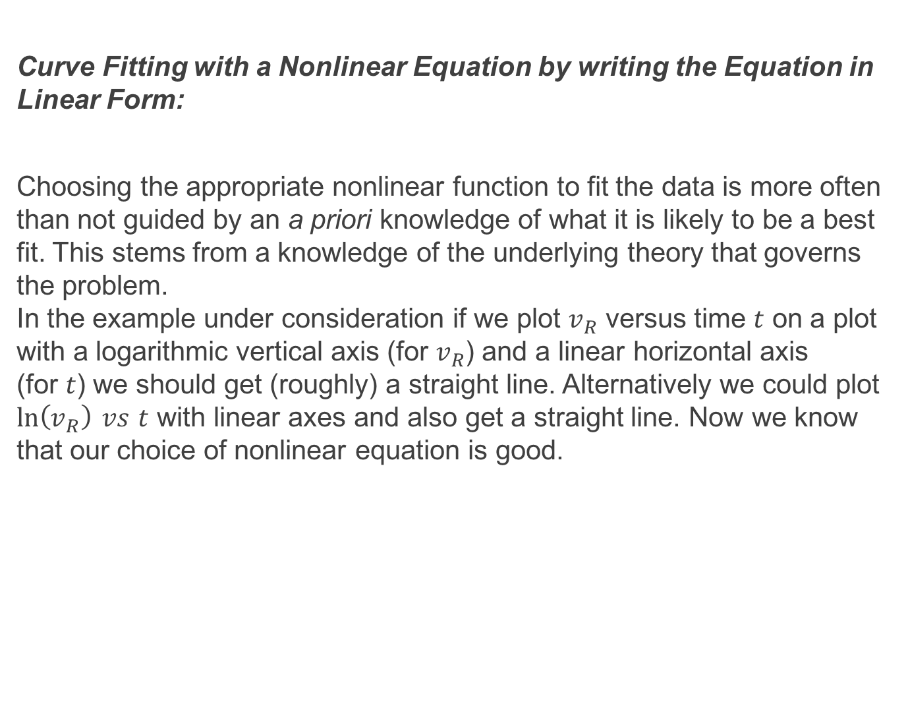
Curve Fitting with a Nonlinear Equation by writing the Equation in Linear Form:
Choosing the appropriate nonlinear function to fit the data is more often than not guided by an a priori knowledge of what it is likely to be a best fit. This stems from a knowledge of the underlying theory that governs the problem. In the example under consideration if we plot $v_{R}$ versus time $t$ on a plot with a logarithmic vertical axis (for $v_{R}$) and a linear horizontal axis (for $t$) we should get (roughly) a straight line. Alternatively we could plot $\ln\left(v_{R}\right) vs$ $t$ with linear axes and also get a straight line. Now we know that our choice of nonlinear equation is good.

Slide 24
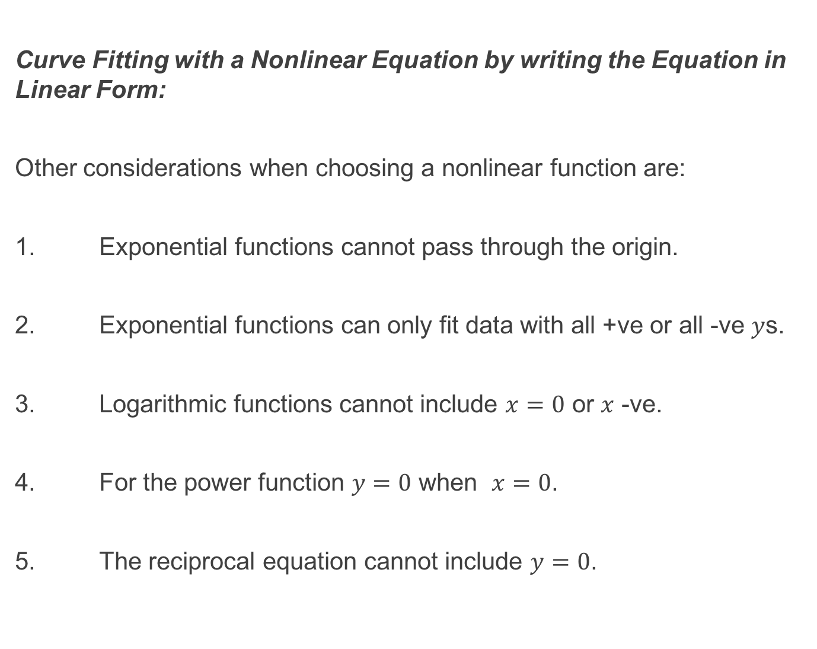
Curve Fitting with a Nonlinear Equation by writing the Equation in Linear Form:
Other considerations when choosing a nonlinear function are:
1. Exponential functions cannot pass through the origin.
2. Exponential functions can only fit data with all +ve or all -ve $y$s.
3. Logarithmic functions cannot include $x=0$ or $x$ -ve.
4. For the power function $y=0$ when $x=0$.
5. The reciprocal equation cannot include $y=0$.

Slide 25
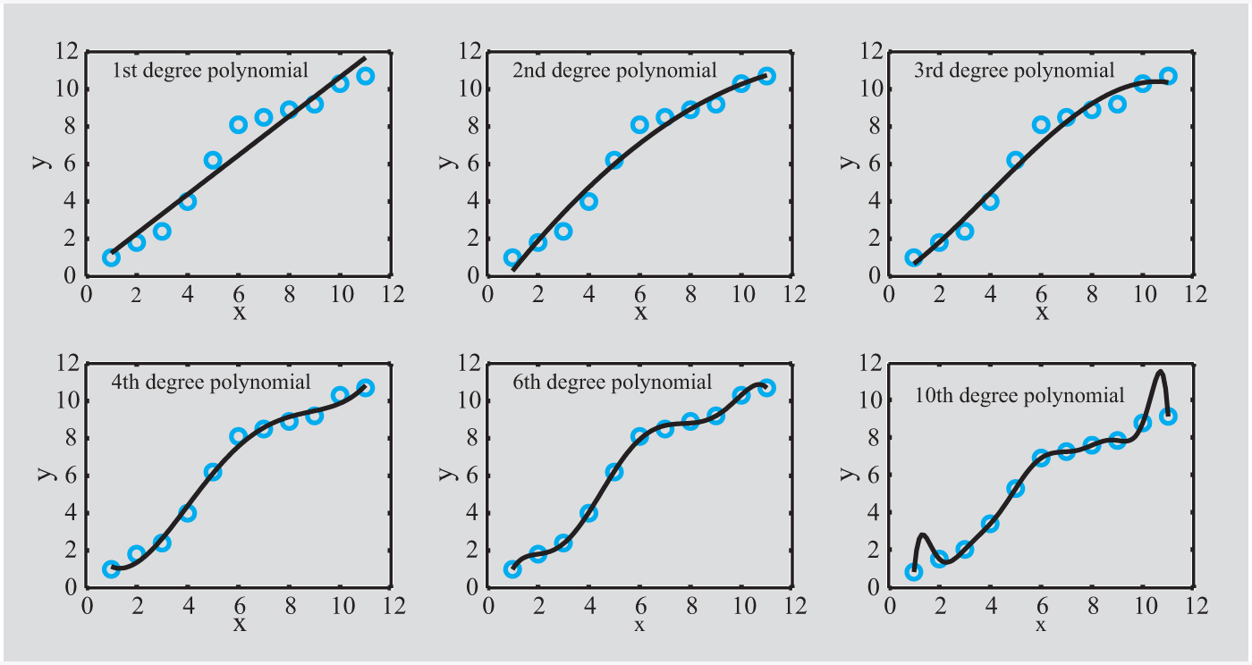
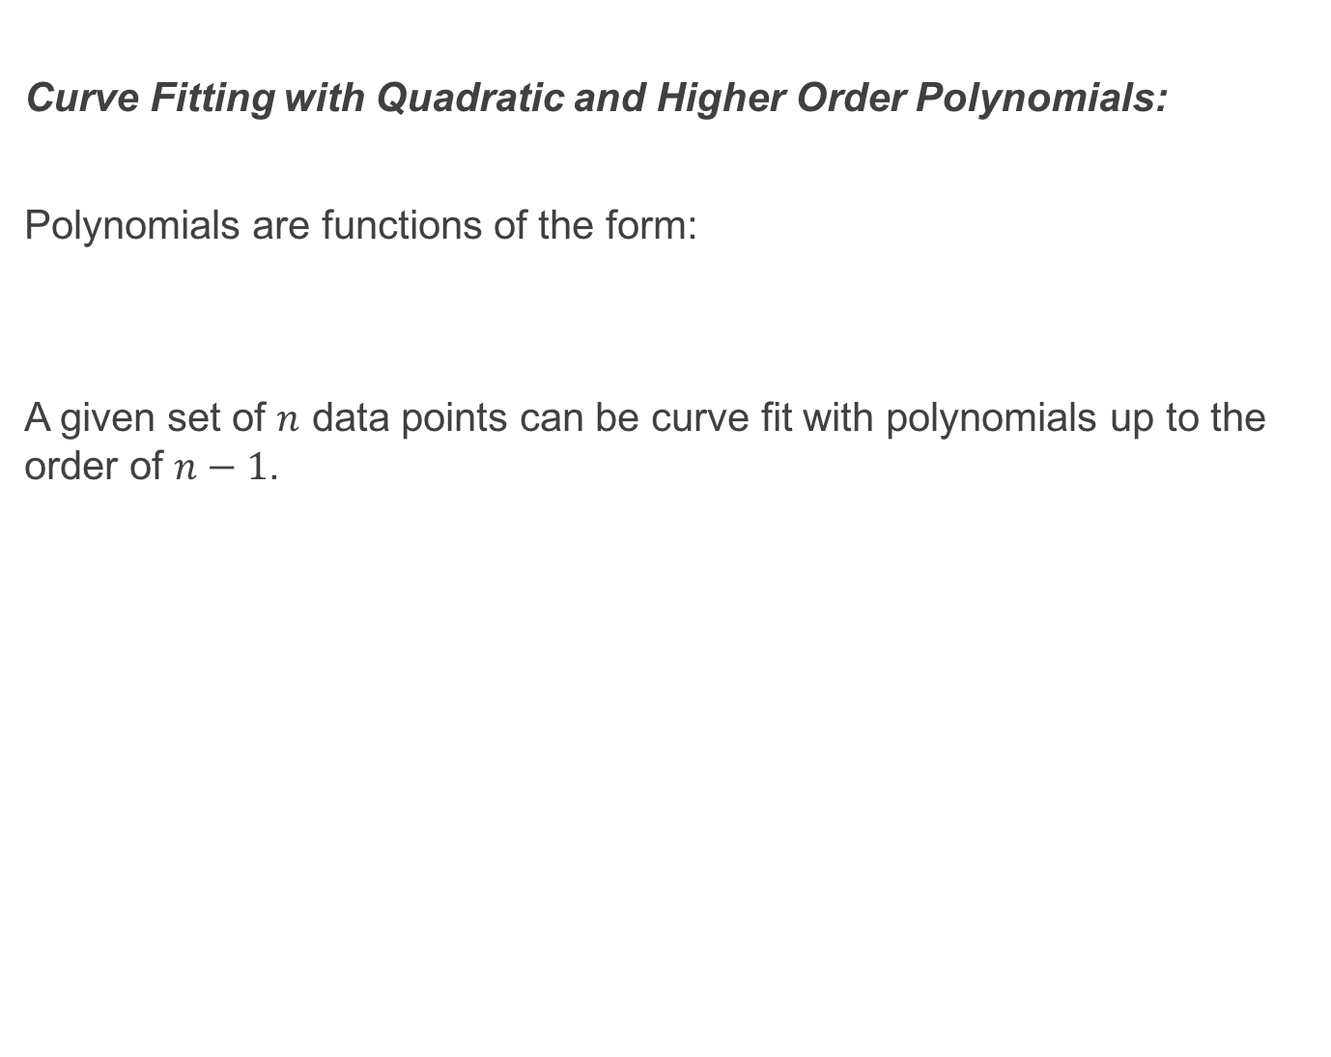
Curve Fitting with Quadratic and Higher Order Polynomials:
Polynomials are functions of the form:
A given set of $n$ data points can be curve fit with polynomials up to the order of $n−1$.

Slide 26
Curve Fitting with Quadratic and Higher Order Polynomials:
The higher the order of the polynomial chosen the more data points it will pass through.
It is very important to note however that higher order polynomials may pass through more points but may deviate significantly from the overall trend between points thus making the approximate governing equation inaccurate.

Slide 27
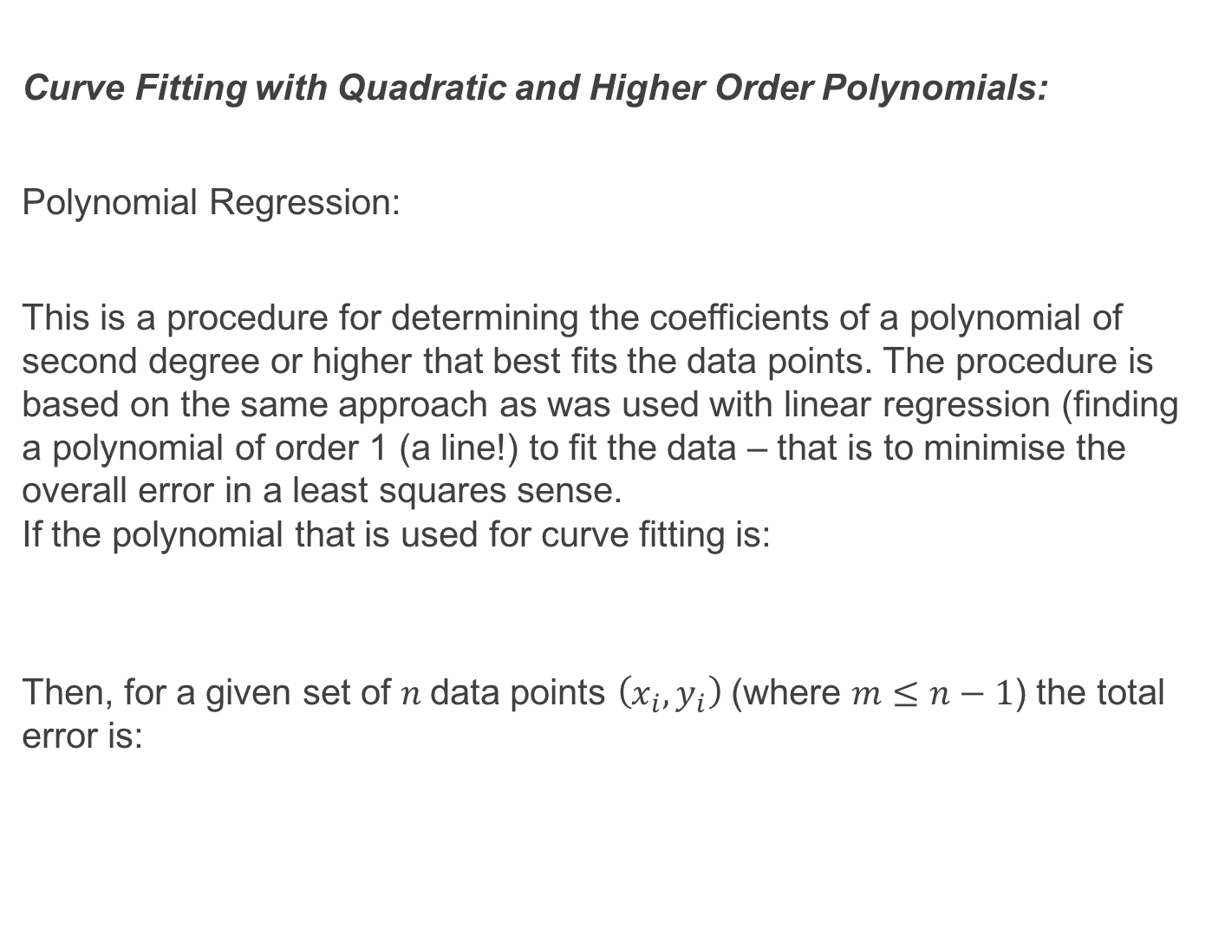
Curve Fitting with Quadratic and Higher Order Polynomials:
Polynomial Regression:
This is a procedure for determining the coefficients of a polynomial of second degree or higher that best fits the data points. The procedure is based on the same approach as was used with linear regression (finding a polynomial of order 1 (a line!) to fit the data – that is to minimise the overall error in a least squares sense. If the polynomial that is used for curve fitting is:
Then, for a given set of $n$data points $\left(x_{i}, y_{i}\right)$ (where $m≤n−1$) the total error is:

Slide 28
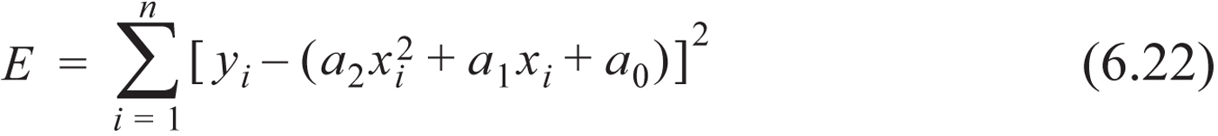
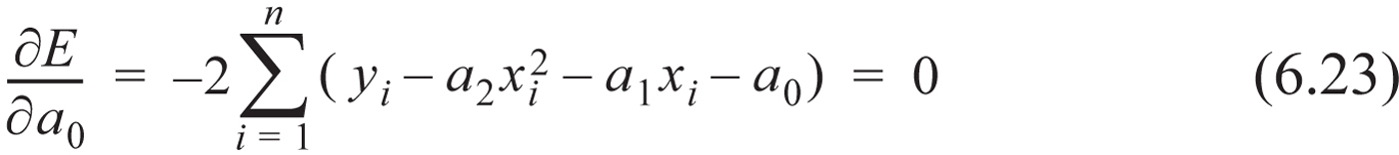
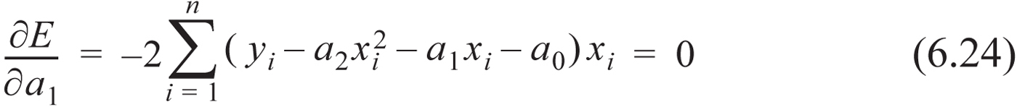
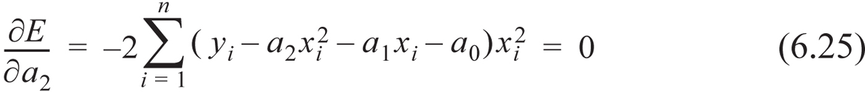
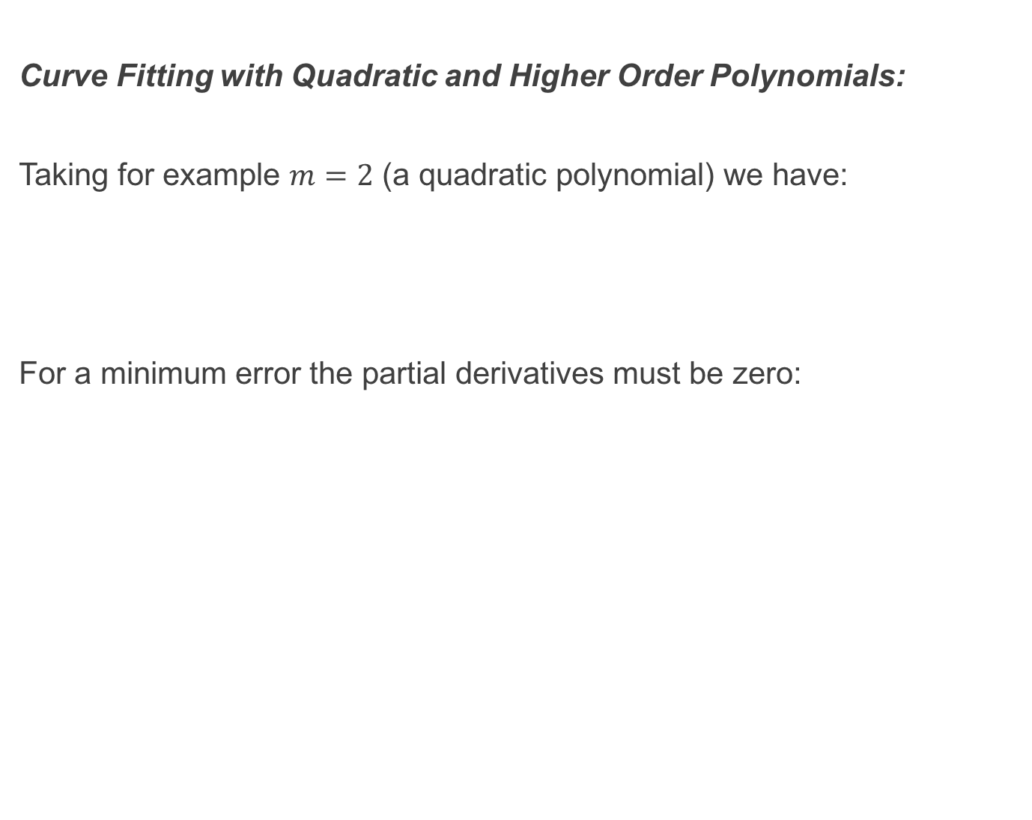
Curve Fitting with Quadratic and Higher Order Polynomials:
Taking for example $m=2$ (a quadratic polynomial) we have:
For a minimum error the partial derivatives must be zero:

Slide 29
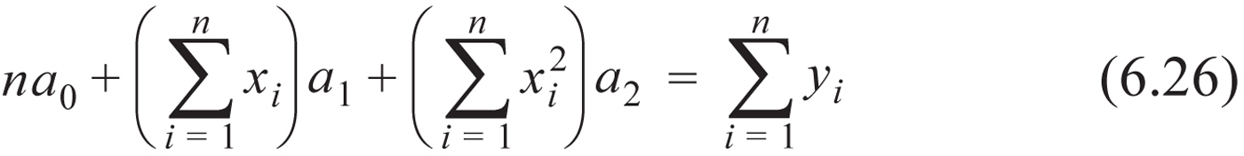
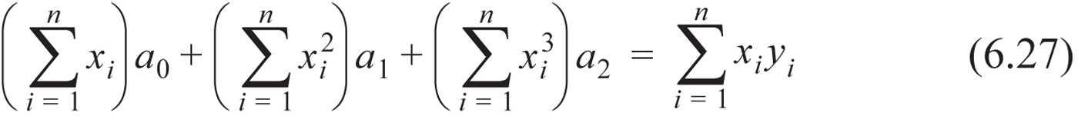
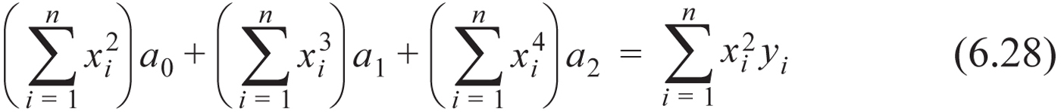
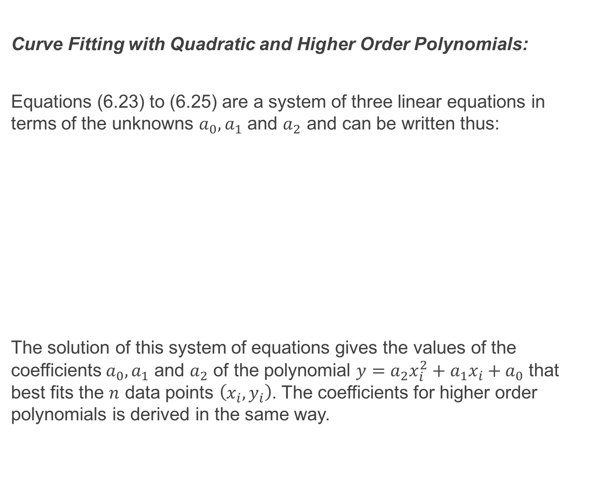
Curve Fitting with Quadratic and Higher Order Polynomials:
Equations (6.23) to (6.25) are a system of three linear equations in terms of the unknowns $a_{0}, a_{1}$ and $a_{2}$ and can be written thus:
The solution of this system of equations gives the values of the coefficients${ a}_{0}, a_{1}$ and $a_{2}$ of the polynomial $y=a_{2}x_{i}^{2}+a_{1}x_{i}+a_{0}$ that best fits the $n$ data points $\left(x_{i}, y_{i}\right)$. The coefficients for higher order polynomials is derived in the same way.

Slide 30


Example:

Slide 31

Example:

Slide 32


Curve Fitting with a Linear Combination of Nonlinear Functions:
To generalise, least squares regression for any type (or types) of function (e.g. the exponential function) we write:
$f_{1}, f_{2} … f_{n}$ are prescribed functions (usually chosen with a fore-knowledge of how the function being fit ought to behave). $C_{1} … C_{m}$ are the unknown coefficients. Using least squares regression Equation (6.91) is used to fit a given set of n points $\left(x_{1}, y_{1}\right)$, … , $\left(x_{n}, y_{n}\right)$ by minimising the total error that is given by the sum of the squares of the residuals:

Slide 33


Curve Fitting with a Linear Combination of Nonlinear Functions:
Minimising $E$ gives:
Substituting Equation (6.92) into (6.93) gives:

Slide 34




Curve Fitting with a Linear Combination of Nonlinear Functions:
Now define:
then Equation (6.94) becomes:
This can be rewritten:
This latter equation is a system of $m$ linear equations in $m$ unknowns ($C_{k})$ and so Equation (6.91) can be satisfied.

Slide 35


Example:

Slide 36
Interpolation using a Single Polynomial:
Interpolation is a procedure in which a mathematical formula is used to represent a given set of data points, such that the formula gives the exact value at the data points and an estimated value between the points.
In contrast to this, curve fitting is the process of obtaining a mathematical formula, from the experimental data, that governs the phenomenon under observation. It is not necessary that the curve fit pass through all data points but rather gives a minimum overall error. The formula can then be used in theoretical calculations regarding this phenomenon including extrapolation.

Slide 37


Interpolation using a Single Polynomial:
For any $n$ points there is a unique polynomial of order $n−1$ that passes through all of these points. For two points the order of the polynomial is 1 – giving us a line. For three points the order of the polynomial is 2 giving us a parabola connecting the points and so on.

Slide 38

Interpolation using a Single Polynomial:
The polynomial can be written in three different forms: standard, Lagrange and Newton’s.
The standard form of an $m^{th}$ order polynomial is:
The equations are written explicitly for each data point by substituting the value of each data point in turn into the polynomial.
This results in a system of linear equations in terms of the polynomial coefficients to be determined.

Slide 39

Interpolation using a Single Polynomial:
For example we have five points which means we have to use a fourth order polynomial to guarantee that it passes through all data points. The data is: (1,2), (4,6), (7,4), (10,8), (13,10).
This system of equations can be solved for the coefficients of the polynomial using any of the methods described previously. However this process is not efficient and the coefficients matrix can be ill-conditioned. Hence we look further to polynomial representation in Lagrange and Newton’s forms.

Slide 40

Interpolation using a Single Polynomial:
Lagrange Interpolating polynomials:
The coefficients of these polynomials can be carried out readily by hand or with a computer.
For a line the first order Lagrange polynomial that passes through two points has the form:
This can be shown to be equivalent to the standard definition for a line passing through two known points

Slide 41



Interpolation using a Single Polynomial:
Substituting two known points into the above equation gives:
Substituting the coefficients back into Equation (6.37) gives:
or
- which is the familiar equation for a line through two known points $\left(x_{1}, y_{1}\right)$ and $(x_{2}, y_{2})$. Note that if $x=x_{1}$ is substituted into Equation (6.40) or (6.41) then the value of the polynomial is $y_{1}.$ Ditto for $x=x_{2}$.

Slide 42


Interpolation using a Single Polynomial:
For three points a second order Lagrange polynomial is used:
Once the coefficients are determined such that the polynomial passes through the three data points the polynomial becomes a quadratic function of $x$ as given in Equation (6.43).
Note when we substitute $x_{1}$ then $f\left(x\right)=y_{1}$. This is because the the coefficient corresponding to $y_{1}$ is $1$ and the other coefficients are zero. This is characteristic of all Lagrange polynomials.

Slide 43



Interpolation using a Single Polynomial:
The general form of a Lagrange polynomial that passes through $n$ points is:
or
where $L_{i}\left(x\right)=\prod_{j=1, j≠i}^{n}{\frac{(x−x_{j})}{(x_{i}−x_{j})}}$ are known as Lagrange functions.

Slide 44

Interpolation using a Single Polynomial:
Notes on Lagrange Polynomials:
1. The spacing between the data points does not have to be equal.
2. For a given set of data points the whole expression for the interpolation polynomial has to be calculated for each interpolation value of $x.$
3. If a data point is added then the whole expression for the polynomial has to be calculated again. This does not have to be done with, for example, Newton’s polynomials.

Slide 45


Example:

Slide 46

Interpolation using a Single Polynomial:
Newton’s Interpolating Polynomials:
The general form of an $n−1$ order Newton’s polynomial that passes through $n$ points is:
The coefficients $a_{i}$ are easily calculated. The major advantage of Newton’s polynomials is that if a data point is added then the previous coefficients remain the same and only the new coefficient needs to be calculated so that the resulting polynomial passes through all points.

Slide 47

Interpolation using a Single Polynomial:
First Order Newton’s Polynomial:
For two data points $\left(x_{1},y_{1}\right)$ and $\left(x_{2},y_{2}\right)$ the first order Newton’s polynomial has the form:
The coefficients can be calculated by evaluating the polynomial for $\left(x_{1},y_{1}\right)$ and $\left(x_{2},y_{2}\right)$ giving:
$$y_{1}=a_{1}+a_{2}\left(x_{1}−x_{1}\right)⟹ a_{1}=y_{1}$$ and
$$y_{2}= a_{1}+a_{2}\left(x_{2}−x_{1}\right)⟹ a_{2}=\frac{y_{2}−y_{1}}{x_{2}−x_{1}}$$

Slide 48



Interpolation using a Single Polynomial: Second Order Newton’s Polynomial:
For three data points the second order Newton’s polynomial has the form:
Substituting $\left(x_{1},y_{1}\right)$ gives $a_{1}=y_{1}$ (as before).
Substituting $\left(x_{2},y_{2}\right)$ gives $a_{2}=\frac{y_{2}−y_{1}}{x_{2}−x_{1}}$ (as before)
and substituting $\left(x_{3},y_{3}\right)$ gives:

Slide 49


Interpolation using a Single Polynomial:
Third Order Newton’s Polynomial:
$a_{1}, a_{2}$ and $a_{3}$ are the same as for Newton’s second order polynomial and

Slide 50


Interpolation using a Single Polynomial:
A General Form of Newton’s Polynomial and its Coefficients:
For two points (a line):
$$a_{1}=y_{1}$$
where $f\left[x_{2},x_{1}\right]$ is known as the first divided difference.

Slide 51



Interpolation using a Single Polynomial:
For three points ($a_{1}$ and $a_{2}$ as before):
For four points ($a_{1}$, $a_{2}$ and $a_{3}$ as before):

Slide 52

Interpolation using a Single Polynomial:
In general the $k^{th}$ divided difference for second and higher divided differences up to the $\left(n−1\right)$ divided difference is:
With these definitions the $\left(n−1\right)$ order Newton’s polynomial is:

Slide 53

Interpolation using a Single Polynomial:
The manner in which the divided differences are related is given in the following diagram:

Slide 54
Interpolation using a Single Polynomial:
Notes on Newton’s Polynomials:
1. The spacing between data points does not have to be the same.
2. Data points can be subsequently added and only one coefficient per extra data point needs to be calculated.
3. The data points do not have to be in any particular order.
For these reasons Newton’s polynomials are a popular choice.

Slide 55


Example:

Slide 56

Piecewise (Spline) Interpolation:
When there are a large number of data points a single order polynomial interpolation may result in large deviations from the general trend (despite the resulting curve passing through all data points) as shown in the figure below:
To circumvent this problem it is possible to use lower order polynomials in a piecewise manner to interpolate. This form of interpolation is called piecewise or spline interpolation and the data points where the polynomials from two adjacent intervals meet are called knots.

Slide 57


Piecewise (Spline) Interpolation:
Linear Splines:
Interpolation is carried out using first order polynomials (linear functions) between the points. In other words the data points are connected with straight lines. Using the Lagrange form, the equation of a straight line that connects two points is given by:
Generalising for successive data points ($\left(x_{i}, y_{i}\right)$ and $\left(x_{i+1}, y_{i+1}\right)$) gives:

Slide 58

Piecewise (Spline) Interpolation:
Interpolation with linear splines is easy to do and gives good results when the data points are closely spaced. For widely spaced points it becomes less accurate because of large changes in the slope of the lines connecting the data points. In this latter respect it is preferable to use higher order polynomials.

Slide 59


Example:

Slide 60


Piecewise (Spline) Interpolation:
Quadratic Splines:
Here second order polynomials are used for interpolation. The polynomial in the $i^{th}$ interval between points $\left(x_{i}, y_{i}\right)$ and $\left(x_{i+1}, y_{i+1}\right)$ is:
For $n$ data points there are $n−1$ intervals and consequently $n−1$ polynomials. Each polynomial has three coefficients so a total of $3\left(n−1\right)$ coefficients have to be determined.

Slide 61

Piecewise (Spline) Interpolation:
The coefficients are determined by applying the following conditions:
1. Each polynomial $f_{i}\left(x\right)$ must pass through the endpoints of the interval $\left(x_{i}, y_{i}\right)$ and $\left(x_{i+1}, y_{i+1}\right)$. This means that $f_{i}\left(x_{i}, y_{i}\right)=y_{i}$ and $f_{i+1}\left(x_{i+1}, y_{i+1}\right)=y_{i+1}$. Put alternately:
Since there are $n−1$ intervals these conditions give $2(n−1)$ equations (two equations per interval).

Slide 62

Piecewise (Spline) Interpolation:
2. At the interior knots (there are $n−2$ of them) the slopes (first derivatives) from adjacent intervals are equal. In general the first derivative of the $i^{th}$ polynomial is:
Equating the successive first derivatives at all of the interior points gives:
Since there are $n−2$ interior points this gives us $n−2$ equations.

Slide 63

Piecewise (Spline) Interpolation:
From 1. and 2. we now have $2\left(n−1\right)+n−2=3n−4$ equations. However the $n−1$ polynomials have $3n−3$ coefficients so we need one more condition so that we can solve for the coefficients. This gives us our third condition:
3. We apply the condition that the second derivative at the first point is zero. The polynomial in the first interval is:
Hence $f_{1}^{′′}\left(x\right)=2a_{1}$. Equating to zero gives $a_{1}=0$ which means that a straight line connects the first two points.
We now have $3n−3$ linear equations (in terms of the coefficients) that allow us to solve for all coefficients.

Slide 64



Example:

Slide 65


Piecewise (Spline) Interpolation:
Cubic Splines:
The equation of the polynomial in the $i^{th}$ interval between points $x_{i}$ and $x_{i+1}$ is:
Overall there are $n−1$ such equations (corresponding to $n−1$ intervals) Since each equation has four coefficients then we need $4(n−1)$ equations (in terms of the coefficients) to solve for these. In like manner with the use of quadratic splines this is performed by imposing $4(n−1)$ conditions on the equations.

Slide 66

Piecewise (Spline) Interpolation:
Conditions imposed on the cubic polynomials to yield the necessary number of simultaneous equations ($4(n−1))$ in terms of the polynomial coefficients:
1. Each polynomial $f_{i}\left(x\right)$ must pass through the endpoints of the interval $\left(x_{i}, y_{i}\right)$ and $\left(x_{i+1}, y_{i+1}\right)$. This means that $f_{i}\left(x_{i}, y_{i}\right)=y_{i}$ and $f_{i+1}\left(x_{i+1}, y_{i+1}\right)=y_{i+1}$. Put alternately: This gives us $2(n−1)$ equations.

Slide 67

Piecewise (Spline) Interpolation:
2. At the interior points the first derivatives (slopes) of the polynomials from adjacent intervals are equal. The first derivative of the $i^{th}$ polynomial is: Equating the first derivatives at each interior point gives:
Since there are $n−2$ interior points we get $n−2$ additional equations.

Slide 68


Piecewise (Spline) Interpolation:
3. At the interior points (knots) the second derivatives of the polynomials from the adjacent intervals must be equal. This means that the rate of change of the slopes at the knots (curvature) must be equal. The second derivative of the polynomial in the $i^{th}$ interval is: Equating the second derivatives at each interior points gives:
Since there are $n−2$ interior points then we have $n−2$ additional equations.

Slide 69
Piecewise (Spline) Interpolation:
4. Lastly we enforce the condition that the second derivatives at the first and last points equal zero. This gives the two remaining equations that we need to solve for all of the coefficients:
Cubic splines whose second derivatives are equal to zero at the end points are known as natural cubic splines.

Slide 70


Piecewise (Spline) Interpolation:
Cubic Splines based on Lagrange form Polynomials: The derivation of cubic splines using the Lagrange form starts with the second derivative of the polynomial. The second derivative of a cubic polynomial is a linear function. For the $i^{th}$ interval this function can be written in the Lagrange form:
Hence the third order polynomial in the $i^{th}$ interval can be obtained by integrating the above equation twice. This results in two constants of integration which can be obtained from the condition that the values of the polynomial at the knots are known:
$f_{i}\left(x_{i}\right)=y_{i}$ and $f_{i}\left(x_{i+1}\right)=y_{i+1}$

Slide 71


Piecewise (Spline) Interpolation:
Once the constants of integration are determined the third order polynomial in the $i^{th}$ interval is:

Slide 72


Piecewise (Spline) Interpolation:
We obtain $n−2$ linear equations by enforcing continuity of the first derivatives at the interior points:
This condition is applied by differentiating Equation (6.82) and substituting these derivatives into Equation (6.83) giving the interpolating polynomial for each interval:
This is a system of $n−2$ equations with $n$ unknowns ($f_{i}^{′′}\left(x_{i}\right)$ and $f_{i+1}^{′′}\left(x_{i+1}\right)$).

Slide 73

Piecewise (Spline) Interpolation:
There remains two equations that are needed to solve for $f_{i}^{′′}\left(x_{i}\right)$ and $f_{i+1}^{′′}\left(x_{i+1}\right)$. As before we enforce the condition that the second derivatives at the endpoints are equal to zero (giving us what are known as natural cubic splines):
Between Equations (6.84) and (6.85) we now have the $2(n−1)$ equations needed to express Equation (6.82).

Slide 74

Piecewise (Spline) Interpolation:
The process of solving for $f_{i}^{′′}\left(x_{i}\right)$ and $f_{i+1}^{′′}\left(x_{i+1}\right)$ can be simplified by defining $h_{i}$ as the length of the $i^{th}$ interval and $a_{i}$ as the second derivative of the polynomial at the point $x_{i}$. That is:
and

Slide 75



Piecewise (Spline) Interpolation:
With these definitions the equation of the polynomial in the $i^{th}$ interval is:
and the system of linear equations that have to be solved for the $a_{i}$s is:
$a_{1}$ and $a_{n}$ are zero – natural splines.

Slide 76


Example:

Slide 77
Recommended Problems:
Problems to be solved by hand (do at least 4):
6.3 (1038 million), 6.8 (0.047 %wt), 6.13 (530W), 6.14 (530W), 6.15 (3.5), 6.16 (502.5 mpg, 515 mpg), 6.17 (525W, 508W), 6.18 (5.152W, 517.3W)
Problems to be programmed in MATLAB:
6.20, 6.21, 6.22, 6.26
Problems in Science and Engineering (do 2):
6.31(a=9.6e+180, b=0.2084, Hc=77.6), 6.41 (m=14.15, b=8.53)
You should pick out problems that you find interesting/challenging and do these too.

